Slide 1
Unit 1
GCSE ICT
(Content reproduced with permission from WJEC)
Notes:
200 slide limit for booklet printing!:

Slide 2
Common topic areas
Data, information and knowledge *
Home entertainment *
Home and personal communications *
Online shopping *
Schools MIS
ICT and learning
Applications software *
Databases *
Email *
Spreadsheets *
Data logging and control
Health issues
Data Protection Act

Slide 3
1
Data and quality of data

Slide 4
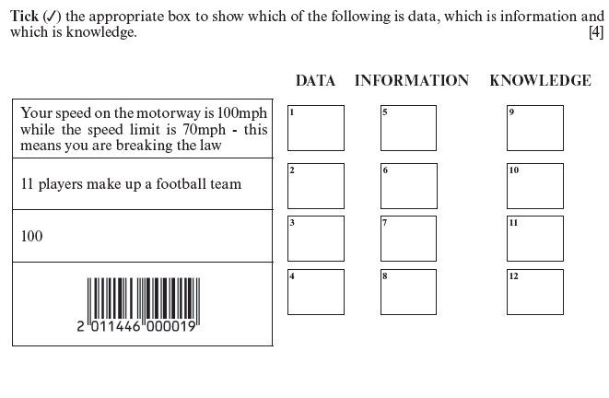
Question 1

Slide 5
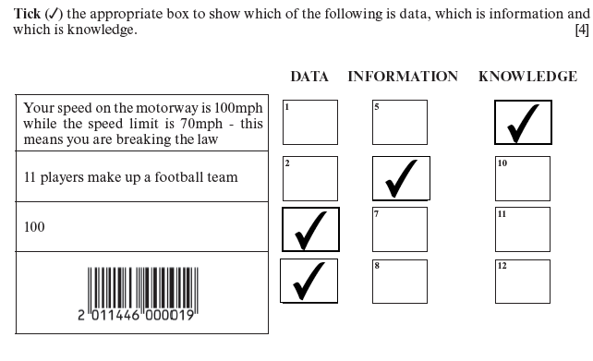
Answer 1

Slide 6
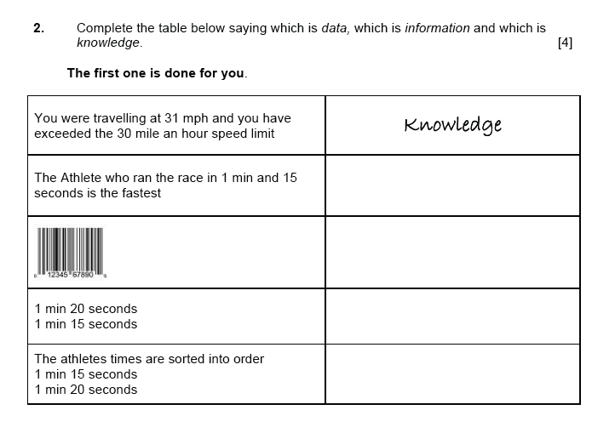
Question 2

Slide 7
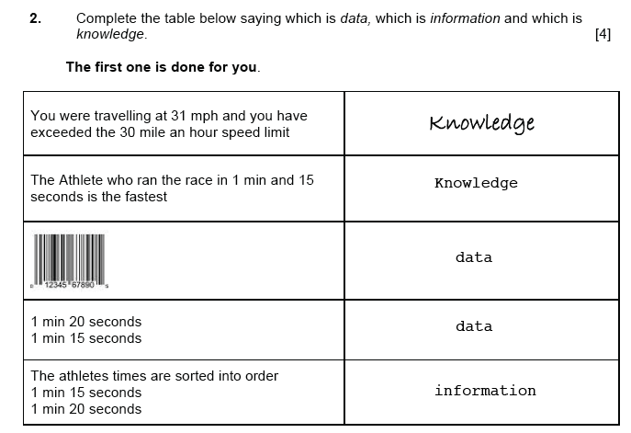
Answer 2

Slide 8
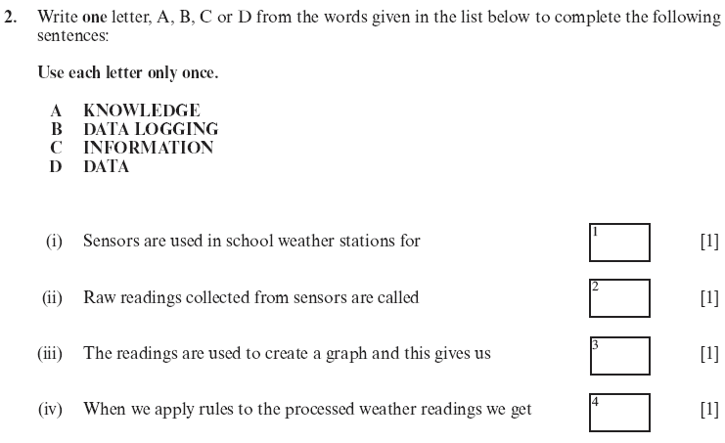
Question 3

Slide 9
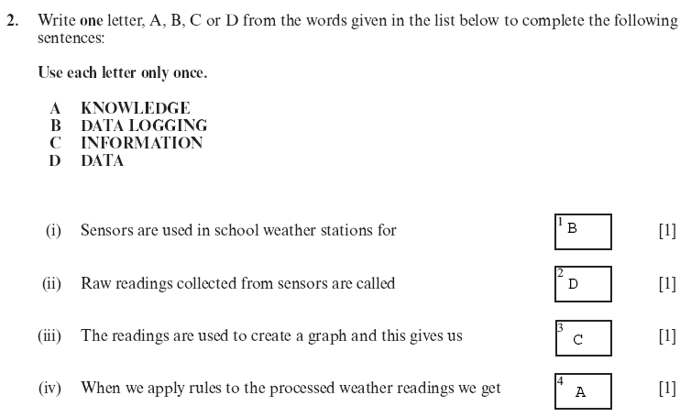
Answer 3

Slide 10
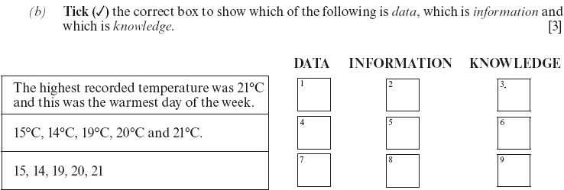
Question 4

Slide 11
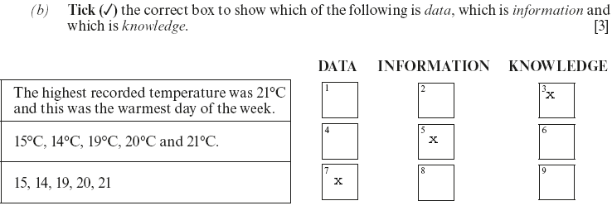
Answer 4

Slide 12
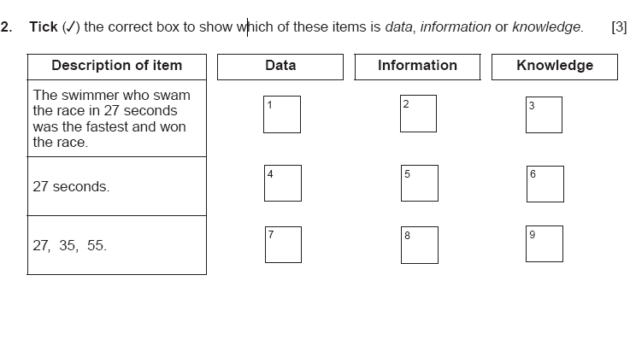
Question 5

Slide 13
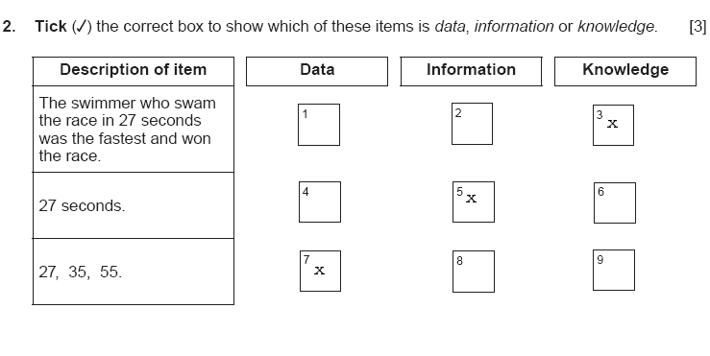
Question 5

Slide 14
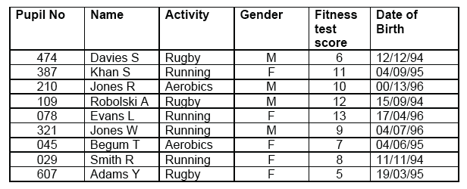
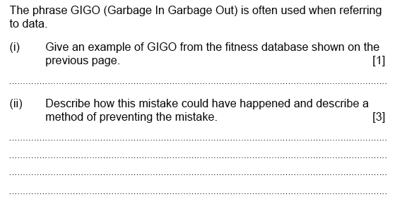
Question 1

Slide 15
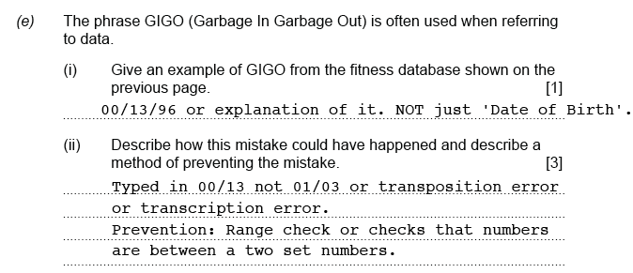
Answer 1

Slide 16
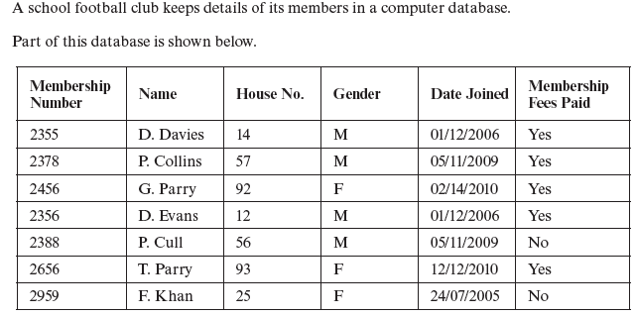
Question 1

Slide 17
Answer 1

Slide 18
2
Home entertainment

Slide 19
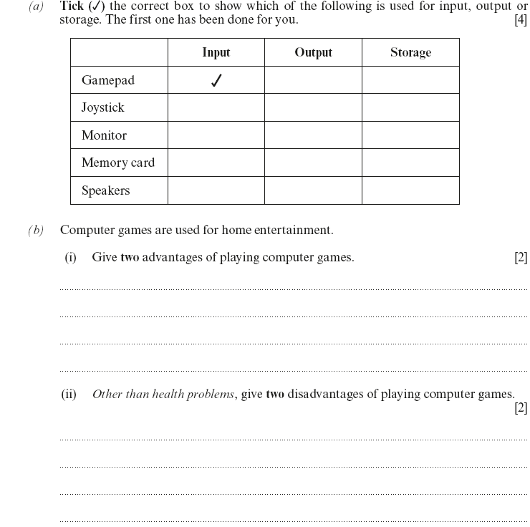
Question 1

Slide 20
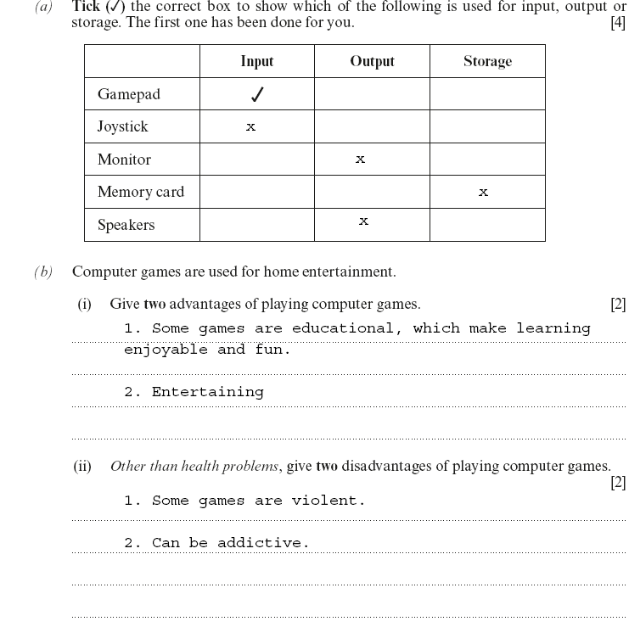
Answer 1

Slide 21
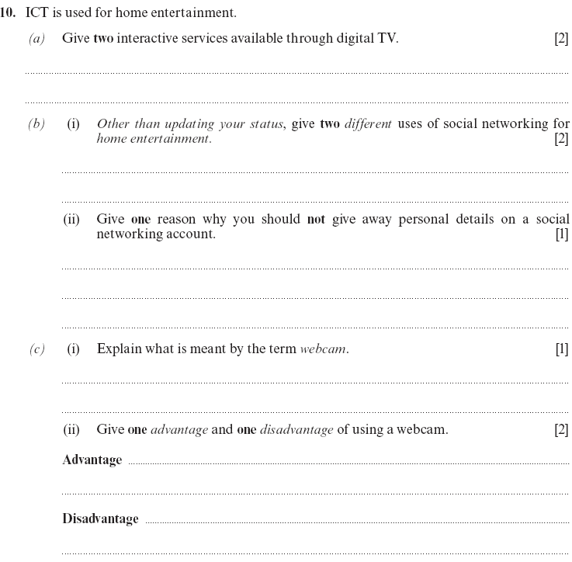
Question 2

Slide 22
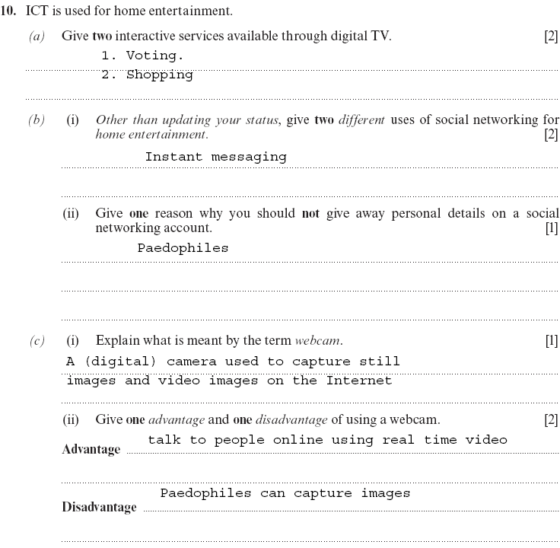
Answer 2

Slide 23
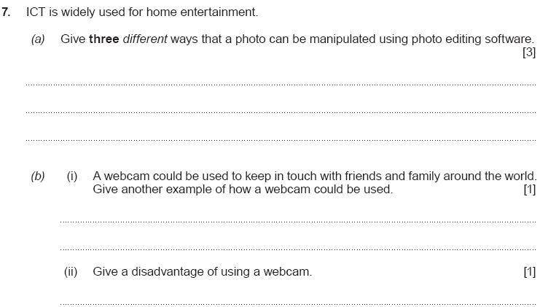
Question 3

Slide 24
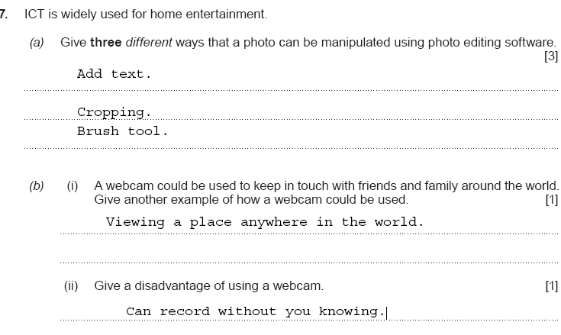
Question 3

Slide 25
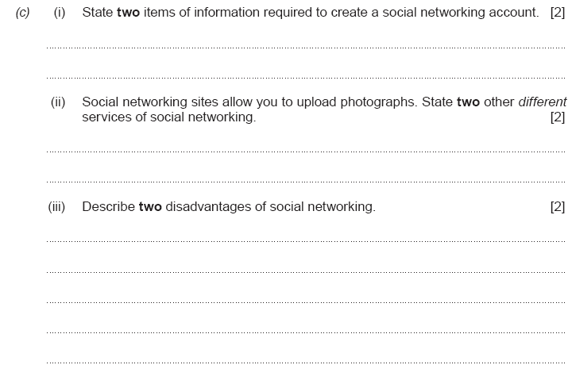
Question 4

Slide 26
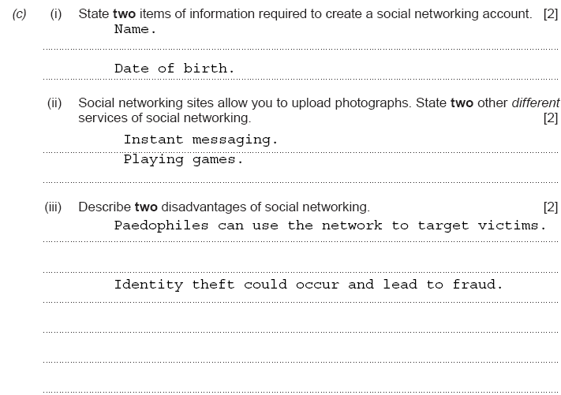
Answer 4

Slide 27
3
Home and personal communications

Slide 28
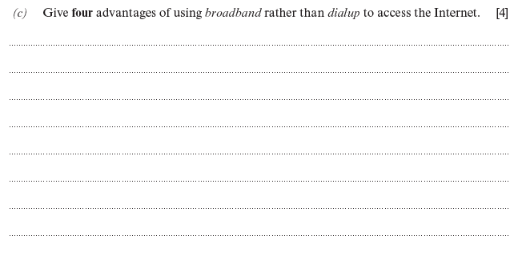
Question 1

Slide 29
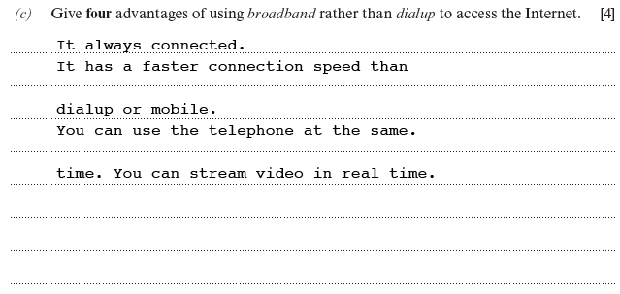
Answer 1

Slide 30
Question 1

Slide 31
Answer 1

Slide 32
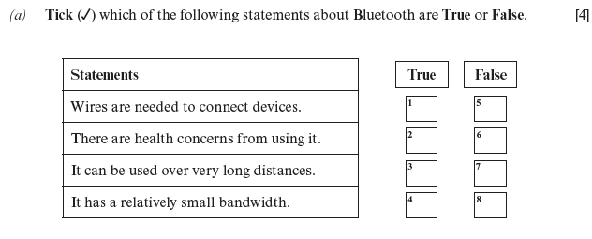
Question 2

Slide 33
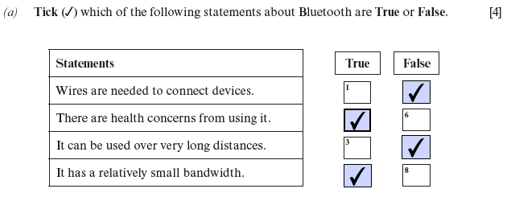
Answer 2

Slide 34
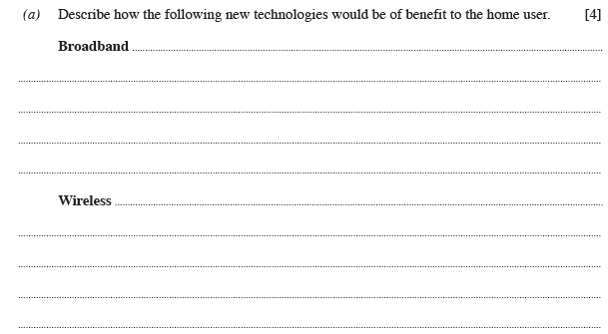
Question 3

Slide 35
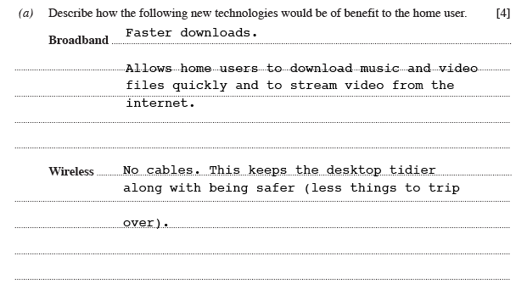
Answer 3

Slide 36
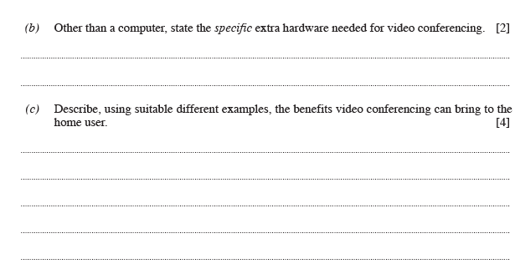
Question 4

Slide 37
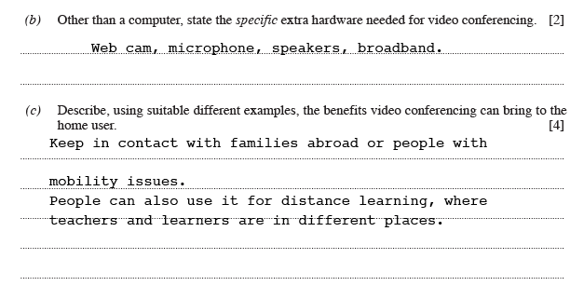
Answer 4

Slide 38
Question 5

Slide 39
Answer 5

Slide 40
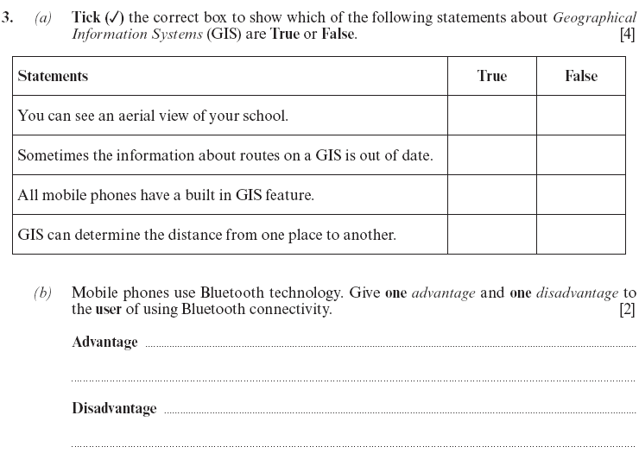
Question 6

Slide 41
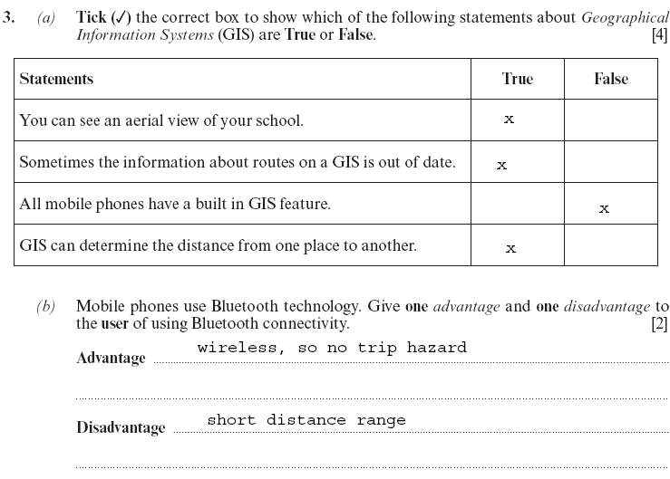
Question 6

Slide 42
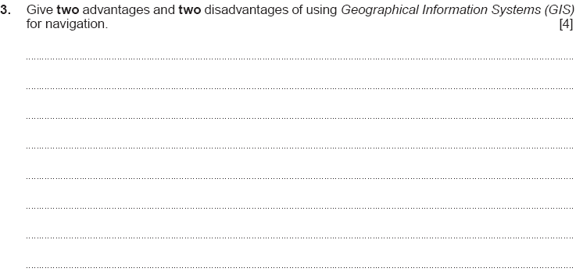
Question 7

Slide 43
Answer 7

Slide 44
4
Online shopping

Slide 45
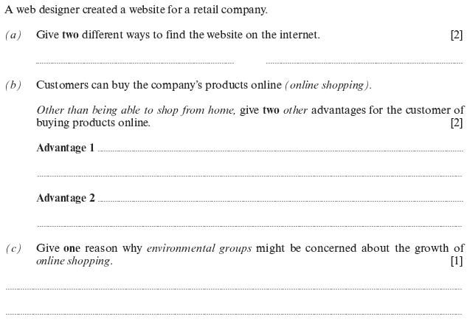
Question 1

Slide 46
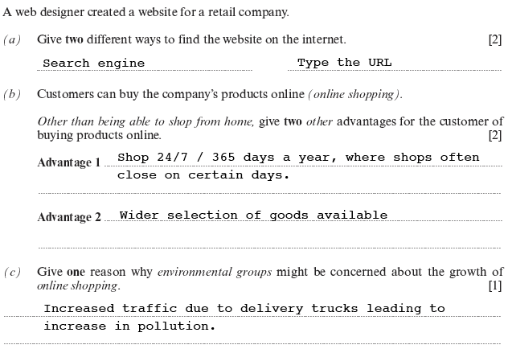
Answer 1

Slide 47
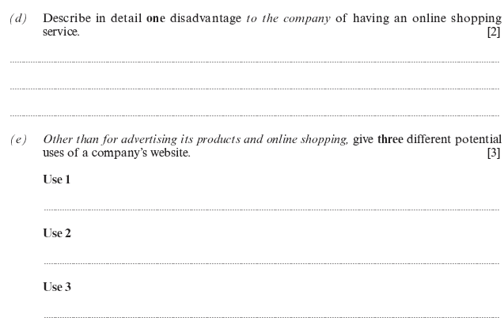
Question 2

Slide 48
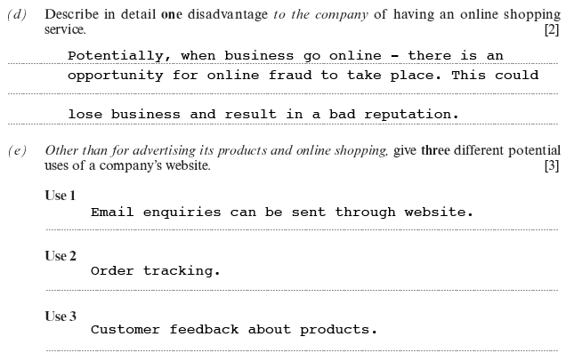
Answer 2

Slide 49
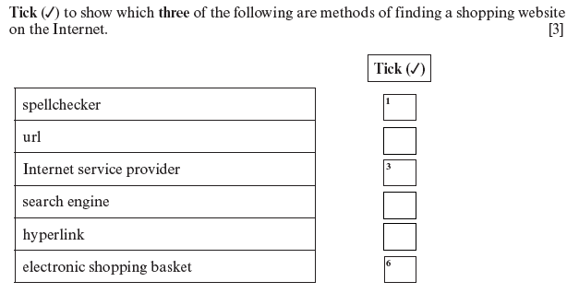
Question 3

Slide 50
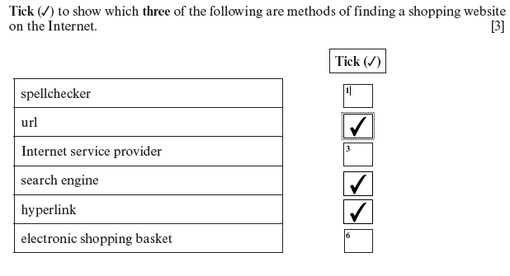
Answer 3

Slide 51
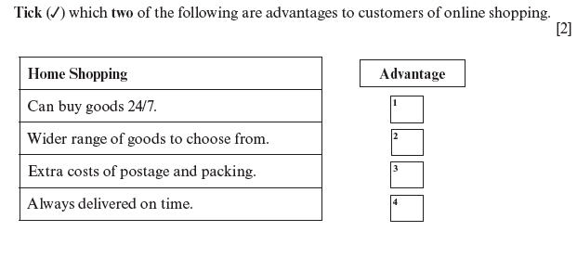
Question 4

Slide 52
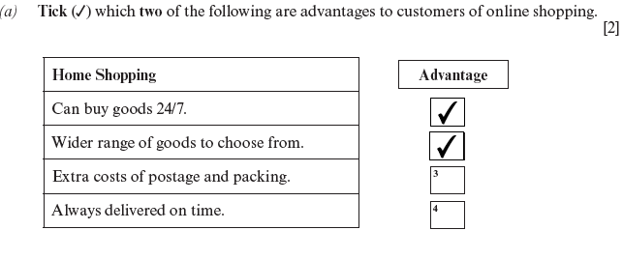
Answer 4

Slide 53
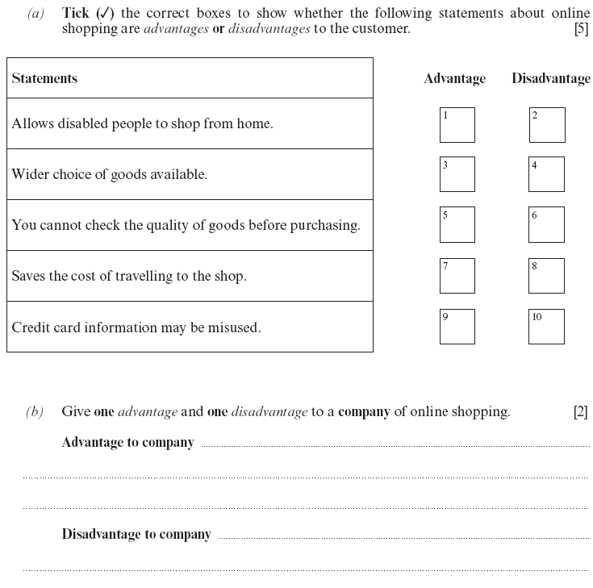
Question 5

Slide 54
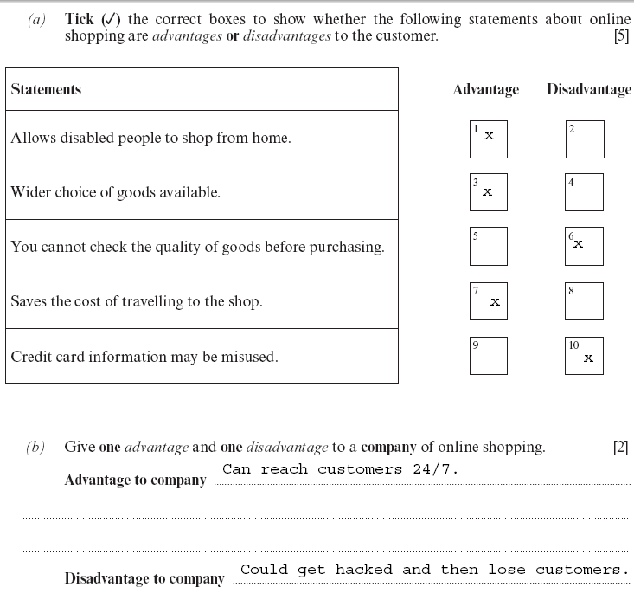
Answer 5

Slide 55
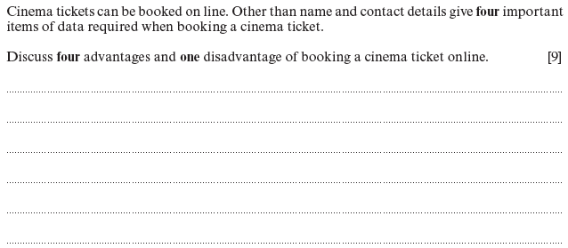
Question 1

Slide 56
The cinema will require Date of performance, Time of performance, Seat number and Film.
Four advantages:
The customer can read reviews about the film online prior to booking.
The customer can look to see which seats are available and pick the preferred seat from a chart.
It is more convenient for disabled people to book online as they don't have to travel.
Booking online will sometimes give special offers.
One disadvantage:
Online fraud could take place resulting in the customer losing money.
Answer 1

Slide 57
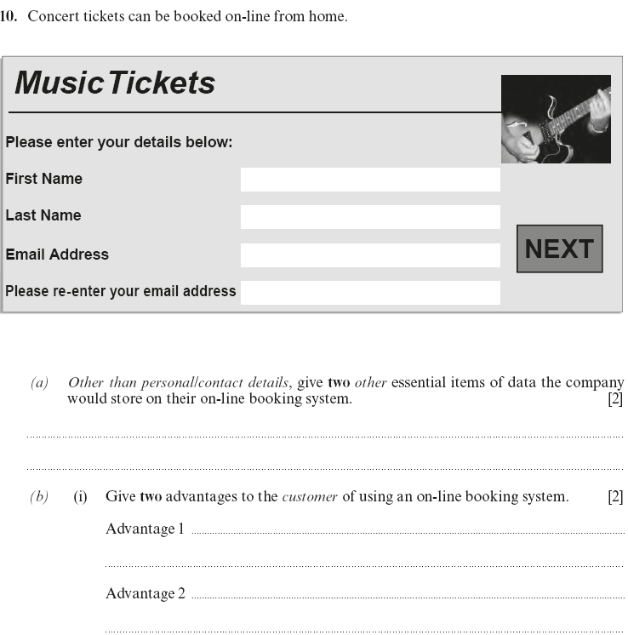
Question 2

Slide 58
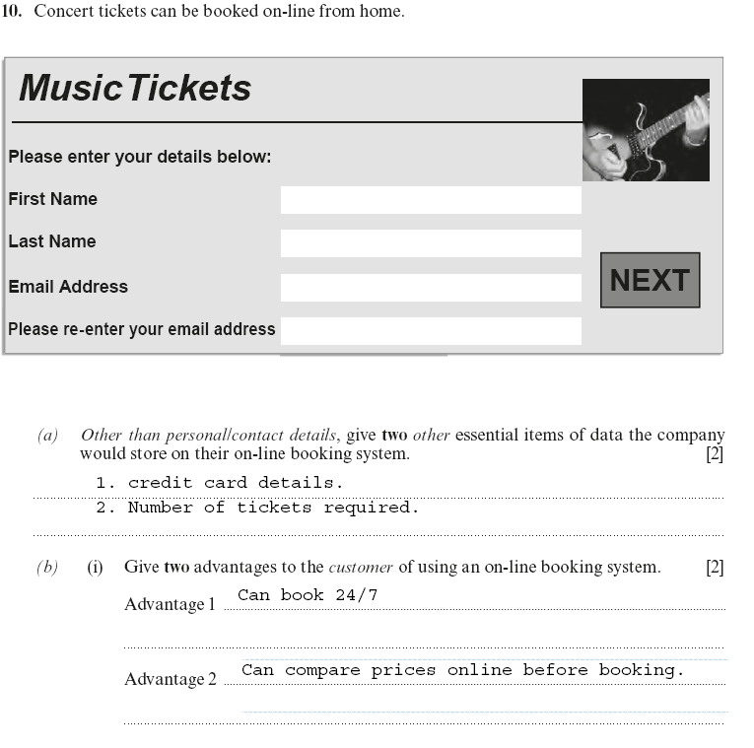
Answer 2

Slide 59
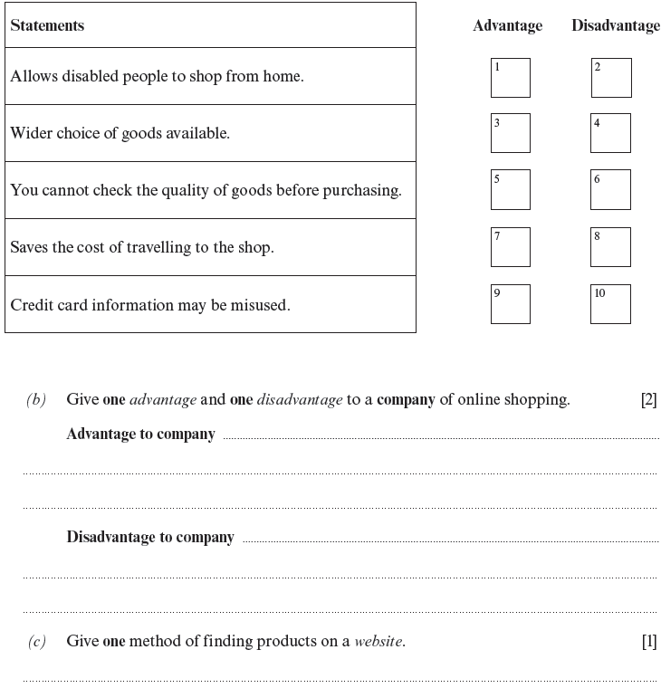
Question 3

Slide 60
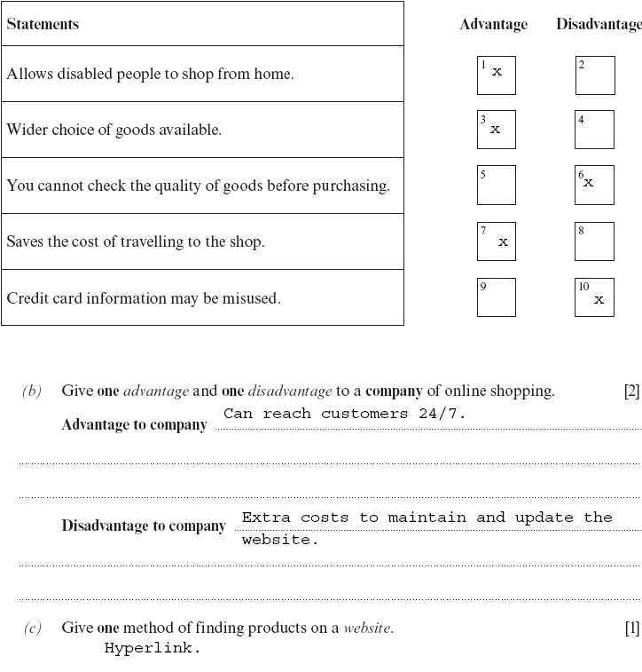
Answer 3

Slide 61
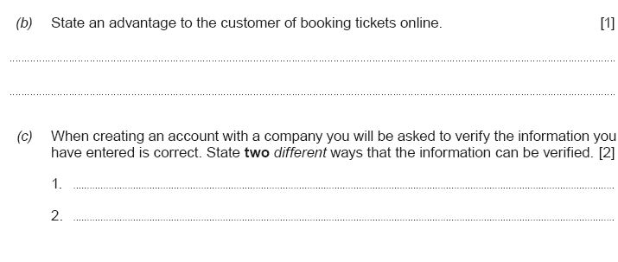
Question 4

Slide 62
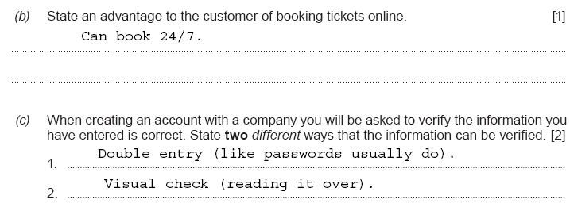
Answer 4

Slide 63
Question 5

Slide 64
Answer 5

Slide 65
5
Organisations: School, Home and Environment

Slide 66
Question 1

Slide 67
Answer 1

Slide 68
Question 2

Slide 69
Answer 2

Slide 70
Question 3

Slide 71
Answer 3

Slide 72
7
ICT & learning

Slide 73
Question 1

Slide 74
Answer 1

Slide 75
Question 2

Slide 76
Answer 2

Slide 77
Question 3

Slide 78
Answer 3

Slide 79
Question 4

Slide 80
Answer 4

Slide 81
Question 5

Slide 82
Answer 5

Slide 83
Question 6

Slide 84
Answer 6

Slide 85
Question 7

Slide 86
Answer 7

Slide 87
8
Applications software

Slide 88
Question 1

Slide 89
Answer 1

Slide 90
Question 2

Slide 91
Answer 2

Slide 92
Question 3

Slide 93
Answer 3

Slide 94
Question 4

Slide 95
Answer 4

Slide 96
Question 4

Slide 97
Answer 4

Slide 98
Question 6

Slide 99
Answer 6

Slide 100
Question 7

Slide 101
Answer 7

Slide 102
Question 8

Slide 103
Answer 8

Slide 104
Question 9

Slide 105
Answer 9

Slide 106
Question 10

Slide 107
Answer 10

Slide 108
9
Databases

Slide 109
Question 2

Slide 110
Answer 2

Slide 111
Question 3

Slide 112
Answer 3

Slide 113
Question 1

Slide 114
Answer 1

Slide 115
Question 2

Slide 116
Answer 2

Slide 117
Question 3

Slide 118
Answer 3

Slide 119
Question 4

Slide 120
Question 4

Slide 121
Question 4

Slide 122
Answer 4

Slide 123
10
Email

Slide 124
Question 1

Slide 125
Answer 1

Slide 126
Question 2

Slide 127
Answer 2

Slide 128
Question 3

Slide 129
Answer 3

Slide 130
Question 4

Slide 131
Answer 4

Slide 132
Question 5

Slide 133
Answer 5

Slide 134
Question 6

Slide 135
Answer 6

Slide 136
Question 7

Slide 137
Question 7

Slide 138
11
Spreadsheets

Slide 139
Question 1

Slide 140
Answer 1

Slide 141
Question 3

Slide 142
Answer 3

Slide 143
Question 5

Slide 144
Answer 5

Slide 145
Question 6

Slide 146
Answer 6

Slide 147
Question 7

Slide 148
Answer 7

Slide 149
Question 9

Slide 150
Answer 9

Slide 151
Question 10

Slide 152
Answer 10

Slide 153
Question 13

Slide 154
Answer 13

Slide 155
12
Data logging and control

Slide 156
Question 1

Slide 157
Answer 1

Slide 158
Question 2

Slide 159
FWD 20
RIGHT 90
FWD 15
RIGHT 90
FWD 5
GRAB
FWD 5
RELEASE
Answer 2

Slide 160
Question 3

Slide 161
Answer 3

Slide 162
Question 1

Slide 163
Answer 1

Slide 164
Question 2

Slide 165
Answer 2

Slide 166
Answer 3

Slide 167
Answer3

Slide 168
Question 4

Slide 169
Answer 4

Slide 170
16
Staying safe online

Slide 171
Question 1

Slide 172
Answer 1

Slide 173
Question 2

Slide 174
Answer 2

Slide 175
17
Data protection act

Slide 176
Question 1

Slide 177
Answer 1

Slide 178
Question 2

Slide 179
Answer 2

Slide 180
18
Health

Slide 181
Question 1

Slide 182
Answer 1

