Slide 1
Make a list
of devices we
use for Home
Entertainment?

Slide 2
Services
Home Entertainment

Slide 3
Lesson Objectives
To define different types of services in regards to home entertainment
To understand the advantages and disadvantages of different devices used in home entertainment
Define the input and output devices needed to interact with home entertainment devices

Slide 4
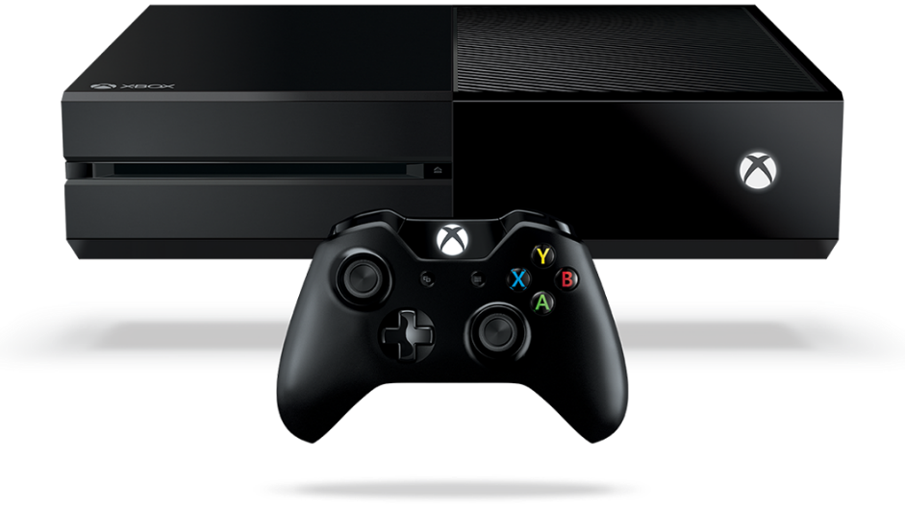
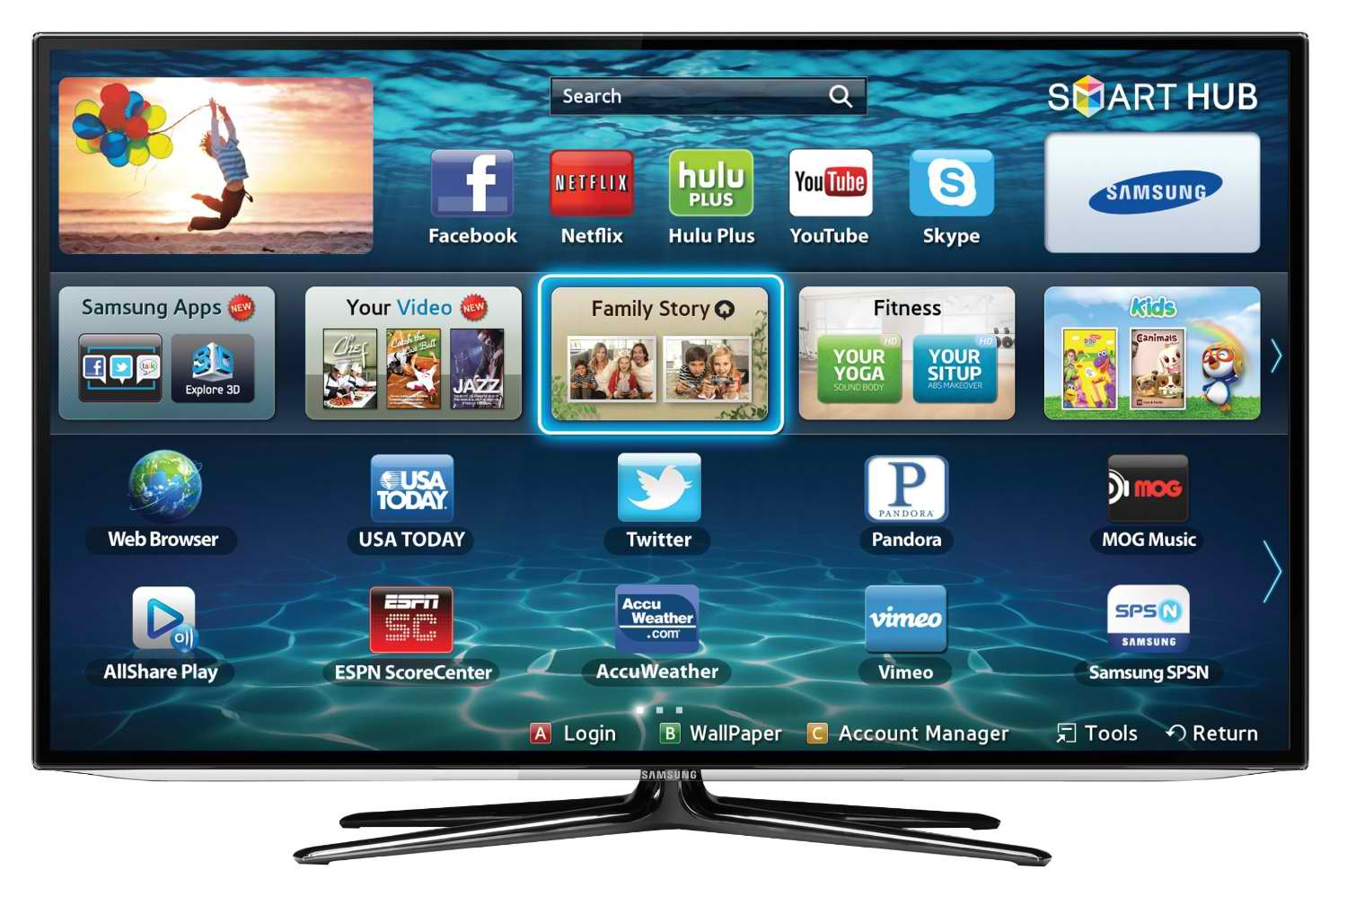
Devices

Slide 5
What services do these offer?
Pay Per View (subscription for events)
Betting
Dating
Shopping
Voting
Gaming

Slide 6
Interactive TV and Games Consoles
How do we interact with them?
Advantages?
Disadvantages?

Slide 7
 | Interactive TV | Games Consoles
What are the advantages to using this service?
What are the disadvantages to using this service?
What can we use to interact with this device?

Slide 8
 | Interactive TV | Games Consoles
What are the advantages to using this service? | User is being active, not passive Number of activities can be carried out by one system Pictures often better quality Often a choice of language Possibilities of interactive learning | Some educational games Games can simulate real life situations and be practised (Learning to fly, not COD) Many games are collaborative – team work Games require thinking and coordination might be developed
What are the disadvantages to using this service? | Possible arguments over which vote to cast or camera view to look at (X Factor and BT Sports) Could lead to lack of social interaction – couch potato Can be expensive | Research says it’s a form of addiction Playing games might limit social development Gamers may not get enough exercise
What can we use to interact with this device? | Remote control Keypad or keyboard | Keyboard Mouse Joystick or gamepad
 | TV Screen Speakers/soundbar | Monitor or screen Speakers

Slide 9
Past
Exam
Questions

Slide 10
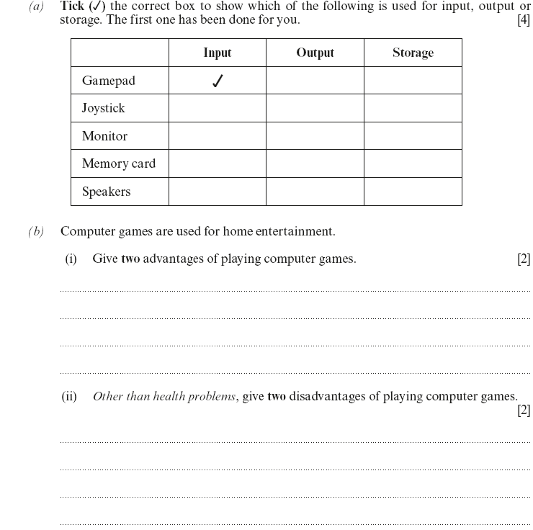
Question 1

Slide 11
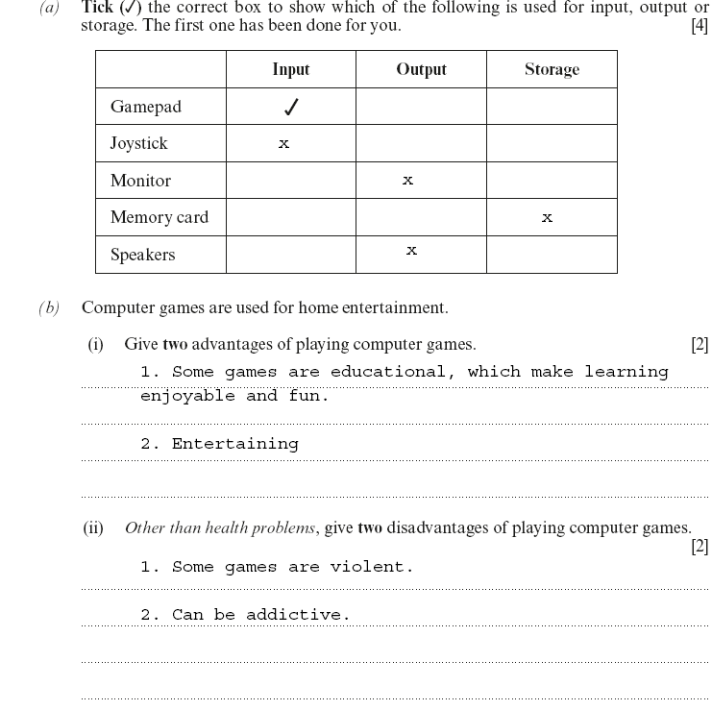
Answer 1

Slide 12
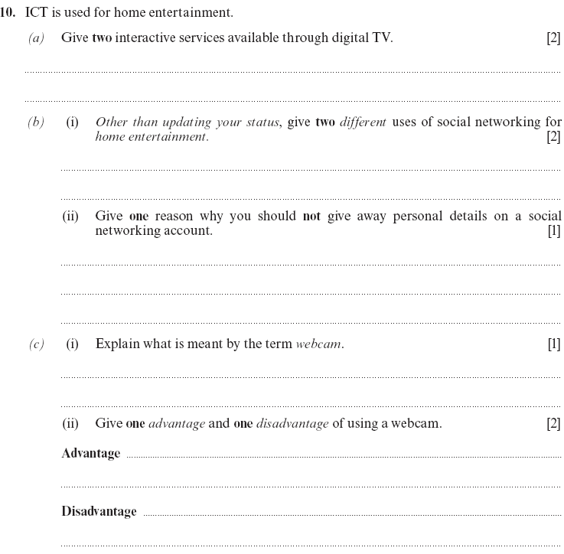
Question 2

Slide 13
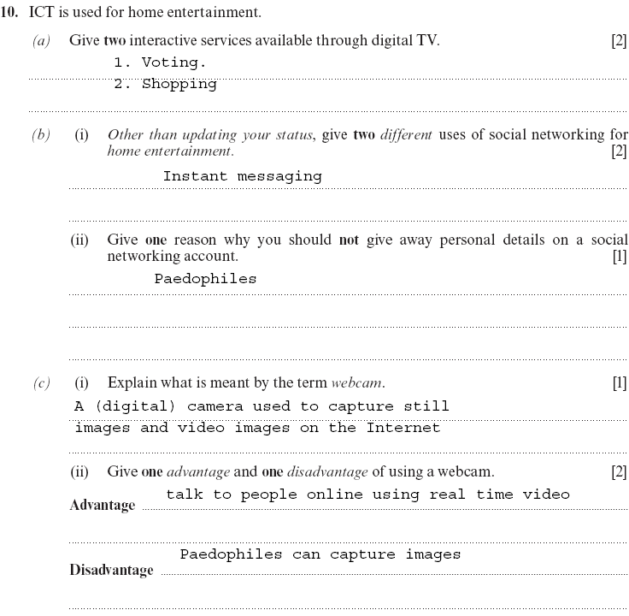
Answer 2

Slide 14
Lesson Objectives
To define different types of services in regards to home entertainment
To understand the advantages and disadvantages of different services
Define the input and output devices needed to interact with home entertainment services

