Slide 1
Legal, Ethical, Safety and Security issues affecting ICT
This learning outcome is all about how legal, ethical, safety and security issues affect how computers should be used. All businesses use computers today for many different reasons and because of this have access to sensitive information about the company, staff and customers. To protect people therefore, laws have been created that stop people misusing computers in order to steal sensitive information. These laws help people affected by computer crime to have some way of recovering any losses that may have been suffered.
The four main laws relating to computer in the United Kingdom are:
Health and Safety
Data Protection
Copyright
Computer Misuse
To ensure that SWS understands the effects of legislation they would like you to create a document to discuss how legislation affects the use of computers within a business.
Learning outcome 4

Slide 2
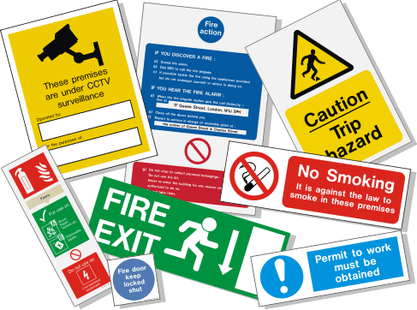
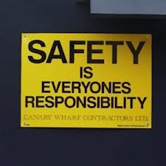
Health and Safety
LO4: How legal, ethical, safety and security issues affect how computers should be used
SWS events would like you to create a document to discuss the features and purposes of computing devices.
Health and Safety
Health and Safety | Almost everyone, not just all employees and employers, has a duty under the Health and Safety at Work Act to work and behave safely. The Act also makes it illegal to act recklessly or intentionally act in such a way as to endanger yourself or others. One of the main laws here is the Health and Safety (Display Screen Equipment) regulation and covers: Checking the workstation of an employee is safe Make sure there are adjustable chairs, monitors, good lighting, etc Making sure employees have regular breaks Arrange and pay for eye tests and glasses if needed Provide health and safety training
Health Problems | Some problems of poor health and safety include: RSI, headaches, back pains and eye strain.

Slide 3
Data Protection
LO4: How legal, ethical, safety and security issues affect how computers should be used
SWS events would like you to create a document to discuss the features and purposes of computing devices.
Data Protection
Data Protection | The Data Protection Act (DPA) aims to protect the rights of the owners of data. The Act sets out rules on how data should be stored and used, and provides a means for the owners of data to complain, and sometimes to claim compensation if their data is misused. The main points of the Data Protection Act include: Data must be fairly and lawfully processed Data must be processed for limited purposes Data must be adequate, relevant and not excessive Data must be accurate and up to date Data must not be kept for longer than is necessary Data must be processed in line with your rights Data must be kept secure Data must not be transferred to other countries outside of the European Economic Area (EEA)

Slide 4
Copyright and Computer Misuse
LO4: How legal, ethical, safety and security issues affect how computers should be used
SWS events would like you to create a document to discuss the features and purposes of computing devices.
Copyright and Computer Misuse
Copyright | The Copyright, Design and Patents Act law makes it illegal to copy a work, for example, a file or image, without permission from the owner or copyright holder. It is also illegal to make unauthorised copies of software. The main ways that this law is commonly broken include: Using software without the correct software licence Downloading files from the internet Copying music, DVDs, CDs and software
Computer Misuse | This Act relates to illegal access to files and data stored on computer systems. It was introduced to cope with the increase in hacking and viruses. There are three main parts to this Act (law): Unauthorised access to computer material Accessing computer material with the intent to commit further illegal acts. Acts with intent to damage operation of computers.

Slide 5
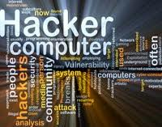
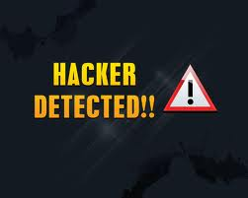
Moral and Ethical Issues
LO4: How legal, ethical, safety and security issues affect how computers should be used
SWS events would like you to create a document to discuss the features and purposes of computing devices.
Moral and Ethical Issues
The use and abuse of personal and private data | The main acts that prevent abuse is the Data Protection Act (DPA) and the Computer Misuse Act (CMA) The Computer Misuse Act (CMA) makes it illegal to hack into a computer system and steal the data that is stored on it. Some problems that could occur include: Accidently deleting or overwriting personal data Employees stealing personal data Employees damaging and destroying data Hacking into a computer to steal data
Cyber Bullying | Cyber bullying is when one person or a group of people try to threaten or embarrass someone else using technology such as a mobile phone or the internet. Cyber bullying can be carried out by people of all ages, at school or in the workplace. It is important that a business recognises the importance of attempting to stop any employees carrying out cyber bullying.

Slide 6
Moral and Ethical Issues
LO4: How legal, ethical, safety and security issues affect how computers should be used
SWS events would like you to create a document to discuss the features and purposes of computing devices.
Monitoring of individuals by organisations
Some businesses need to monitor tasks that are being completed. There are several ways in which employees and other individuals (for example, customers) can be monitored: Worker Monitoring/Logging: CCTV and RFID tags can be used to track employees. Cookies: A file downloaded to the computer from a website so that it can be personalised. Cookies can be a problem as they store personal data on the computer. Key Logging: A key logger is a piece of hardware or software that records the real time activity of a computer user including the keyboard keys they press. Worker Call Monitoring/Recording: Many businesses record telephone calls made from and to the business. This enables an audit trail to be kept in case of any issues or questions being raised at a later. Electronic Surveillance: Many businesses offer a loyalty card scheme. Every time a customer shops online or in the store, the loyalty card number is obtained and points are allocated to the account. This gives the business detailed data about customers. Mobile Phone Triangulation: Mobile phone positioning can be used by the emergency services (police, fire, ambulance or mountain rescue) to find the exact location that a call was made. However, finding the position of a mobile phone, and the person using it, can invade the privacy of the phone user.

Slide 7
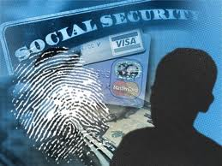
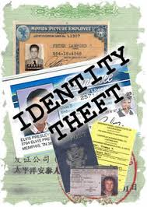
Data Loss, Corruption and Theft
LO4: How legal, ethical, safety and security issues affect how computers should be used
SWS events would like you to create a document to discuss the features and purposes of computing devices.
Data Loss, Corruption and Theft
Legal implications | The Data Protection Act is concerned with keeping data secure. If the data is lost or stolen then this principle has been broken. A business can have criminal proceedings started against them and may have to pay financial compensation to any person whose data is lost/stolen. If data has been stolen through hacking then the legislation that can be used is the Computer Misuse Act. If the hacker is traced, then the business can allow the police to prosecute them. This could result in the hacker being imprisoned and having to pay a large fine. In addition, the hacker may also have to pay compensation to the business.

Slide 8
Data Loss, Corruption and Theft
LO4: How legal, ethical, safety and security issues affect how computers should be used
SWS events would like you to create a document to discuss the features and purposes of computing devices.
Data Loss, Corruption and Theft
Impact on customers | If the personal data of the customers is lost, stolen or corrupted then this can have a serious impact on the customer and the business. It is very likely that the business will no longer be seen as trustworthy by its customers and the confidence that the customers. If personal data is lost, stolen or corrupted then there is an increased risk of the customers being the victims of identity theft. Identity theft means that someone takes over the identity of another person and can create big debts, etc.

Slide 9
Data Loss, Corruption and Theft
LO4: How legal, ethical, safety and security issues affect how computers should be used
SWS events would like you to create a document to discuss the features and purposes of computing devices.
Data Loss, Corruption and Theft
Impact on employees | If data was to be lost, stolen or corrupted as a result of actions by an employee then there may be a great impact on the employee responsible. An employee may face disciplinary action if their actions resulted in data being lost, stolen or corrupted. These actions could be: A formal written warning A demotion in job role and a reduction in salary Dismissal from their job A reference being given which stated why they lost their job – this could result in difficulty in finding another job
Impact on the business (organisation) | They will have to pay compensation to customers. They may have to close down because of the costs. More money will have to be spent on computer security. Customers might lose confidence in the business.

Slide 10
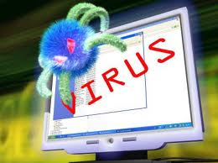
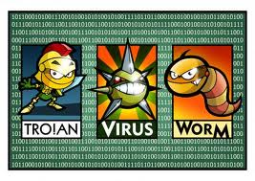
Threats to Data Security
LO4: How legal, ethical, safety and security issues affect how computers should be used
SWS events would like you to create a document to discuss the features and purposes of computing devices.
Threats to Data Security
Computer Viruses | A computer program that can replicate itself and spread from one computer to another. Viruses can increase their chances of spreading to other computers by infecting files on a network file system.
Trojans | A Trojan often appears to be something which is wanted or needed by the user of a PC but is a stand-alone program designed to give full control of a PC infected with a Trojan to another PC. They can be hidden in valid programs and software. Trojan horses can make copies of themselves, steal information, or harm their host computer systems.
Worms | A stand-alone computer program that replicates itself so it can spread to other computers. A worm can use a computer network to spread. Unlike a computer virus, it does not need to attach itself to an existing program. Worms almost always cause some harm to a network, even if only by consuming bandwidth.

Slide 11
Threats to Data Security
LO4: How legal, ethical, safety and security issues affect how computers should be used
SWS events would like you to create a document to discuss the features and purposes of computing devices.
Threats to Data Security
Phishing | A way of attempting to get information, for example usernames, passwords and credit card details, by pretending to be from a trustworthy source such as a social network or banking website. Phishing is usually carried out by email spoofing or instant messaging. Users are often asked to enter details at a fake website which looks just like the proper version.
Spyware | A type of malware (malicious software) installed on a computer system that collects information about users without their knowledge. Spyware is usually hidden from a user and can be difficult to detect.
Adware | Also known as advertising-supported software. This is any software package that automatically shows adverts, such as a pop up. The main object of adware is to generate money for its author. Adware, by itself, is harmless. However, some adware may include spyware such as key loggers.

Slide 12
Threats to Data Security
LO4: How legal, ethical, safety and security issues affect how computers should be used
SWS events would like you to create a document to discuss the features and purposes of computing devices.
Threats to Data Security
Hacking | Hacking means finding out weaknesses in a system. A computer hacker is a person who finds out weaknesses in a computer system to gain unauthorised access. A hacker may be motivated by a multitude of reasons, such as profit, protest or challenge.
Denial of Service Attacks (DoS) | This is an attempt to make a computer or network system unavailable to its users. A DOS attack is usually focused on preventing an internet site or service from functioning efficiently or at all, temporarily or indefinitely. The attacks usually target sites or services hosted on high-profile web servers such as banks and payment websites (for example, PayPal).
Physical threats | Computer systems consist of physical items such as keyboards, monitors, memory sticks/removable storage devices, base units and servers. These can be lost or stolen very easily – especially memory sticks and portable storage devices.

Slide 13
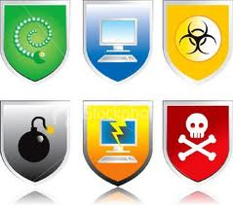
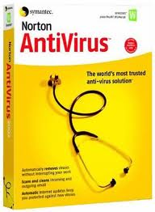
Action to Minimise Risks
LO4: How legal, ethical, safety and security issues affect how computers should be used
SWS events would like you to create a document to discuss the features and purposes of computing devices.
Action to Minimise Risks
Act appropriately online to reduce and Protect Personal Security | Do not share to much information online, especially when on social networking sites, i.e. your date of birth. Use different passwords on different sites. Always check the website for the padlock and https and beware of emails that ask for your information.
Firewall | A firewall is used to help protect a computer system from threats and attacks. This is done by controlling what data can and cannot pass through it.
Anti-Virus | This software detects any viruses, including Trojans and worms, and removes them to limit their damage and impact to the computer system.
Anti-Spam | Email Spam is the sending of unwanted messages, often advertising, to a large number of email addresses. Spam is a serious concern as it can be used to deliver Trojans, viruses, worms, spyware, etc.
Data Encryption | This software encrypts data so that only users who have the unlock code/secret key can read/use the data which has been transmitted.

Slide 14
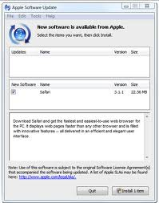
System Updates
LO4: How legal, ethical, safety and security issues affect how computers should be used
SWS events would like you to create a document to discuss the features and purposes of computing devices.
System Updates
Automatic Operating System and Software updates | Many operating systems have the facility to update automatically. These usually happen when the computer system is going through the shutdown process. Security software such as an anti-virus also update automatically and will find updates, download them and install the updates without the need for user interaction.

Slide 15
System Updates
LO4: How legal, ethical, safety and security issues affect how computers should be used
SWS events would like you to create a document to discuss the features and purposes of computing devices.
System Updates
Manual Operating System and Software updates | Manually updating operating systems and security software can be dangerous to the computer system and the data that is held on it. A manual update can be forgotten by an employee and this can leave the computer system vulnerable to threats. One of the problems with manual updating of software is the time it can take to download the patch. There may also be a time delay between the patch being released by the software vendor and the time when the manual update takes place. Some users, however, may decide to manually update the software because they want to look at the updates to decide whether or not to download them.

