Slide 1
Communication Methods
LO3: How ICT can be used to support business working practices
SWS events would like you to create a document to discuss the features and purposes of computing devices.
Communication methods and how they support businesses
Type | Description | Advantages | Disadvantages
Voice telephones | These can be a fixed landline or mobile phone and allow people to talk to each other | Calls can be put on hold Voicemail messages can be left Phone calls can be at a set location or portable (mobiles) | Landlines may not be answered Mobiles may have poor signal Time difference a problem
SMS | Short Message Service and allows people to send and receive text messages using mobile phones | It’s cheap (e.g. SMS packages) Short messages can be sent Can communicate quickly with people around the world | Only short messages sent Some people find people texting difficult May not be delivered
Instant messaging | Here messages are typed and sent in real time over the Internet | Messages sent and received instantaneously Files and pictures can be sent It can be used to talk to multiple people at once | Emotions cannot be expressed as easily as when talking to someone Virus could be sent through the files and pictures

Slide 2
Communication Methods
LO3: How ICT can be used to support business working practices
SWS events would like you to create a document to discuss the features and purposes of computing devices.
Communication methods and how they support businesses
Type | Description | Advantages | Disadvantages
Email | Electronic Mail which allows messages to be sent and received over the Internet with attachments | Emails can be sent to multiple people at once Good for quick communication Attachments can be added Various devices can access emails such as smartphones Staff/Customer emails can be stored and used | Emails can be misunderstood Emails could be sent to the wrong person People may not receive the email if there is no Internet Viruses could be attached Email can be hacked into or spam could be sent
Chat rooms | This is a site on the Internet that allow people to chat to each other in real time, usually around a topic | Brings together people with interests in a particular topic Some people may be in remote areas and need other way to find answers | Information might not be correct You cannot be sure who you are communicating with

Slide 3
Communication Methods
LO3: How ICT can be used to support business working practices
SWS events would like you to create a document to discuss the features and purposes of computing devices.
Communication methods and how they support businesses
Type | Description | Advantages | Disadvantages
Forum | This is an Internet site that people can communicate on and usually ask questions and gain answers. They are not real time and responses can be delayed | Ideas can be shared between users Posts/Threads can be read and reread as many times as needed | They can be time consuming to manage and monitor Comments/Posts are not available in real time
Bulletin Boards | This allows people to post information on a website and can only be accessed by people with the correct user permissions | Any registered user can make comments that can be viewed by all users of the boards General discussion on topics with interesting and useful comments able to be given | Any registered user can make comments and may be wrong Needs to be moderated by a responsible/trustworthy person

Slide 4
Communication Methods
LO3: How ICT can be used to support business working practices
SWS events would like you to create a document to discuss the features and purposes of computing devices.
Communication methods and how they support businesses
Type | Description | Advantages | Disadvantages
VoIP | VoIP or Voice Over Internet Protocol allows human voice (analogue) to be converted to digital so that telephone calls can be made over the Internet | With a broadband (Internet) calls from PC-to-PC are free Calls can be made wherever there is an Internet connection Lots of features such as call forwarding, voicemail, caller ID and three-way calling Documents, images, etc. can be sent while talking | PC to voice calls expensive No service during power cut Poor/limited Internet can reduce call quality Using a PC at the same time can reduce the call quality
Videoconferencing | This allows two-way communication over the Internet using webcams and/or microphones and software such as Skype | People don’t need to travel to meetings reducing travel costs People can be anywhere around the world Better for the environment | Time zones around the world can make calls difficult Equipment needs maintaining Training might be needed To take part in the conference everyone needs to equipment

Slide 5
Communication Methods
LO3: How ICT can be used to support business working practices
SWS events would like you to create a document to discuss the features and purposes of computing devices.
Communication methods and how they support businesses
Type | Description | Advantages | Disadvantages
Webcams | Video camera that allows live video to be streamed on a computer and over the Internet | When combined with the Internet it can be used for video conferencing Communication is real time and face-to-face | Can be expensive to buy if advanced features are needed Does not fully show human reactions in the conversation
Blogs | A website on which individuals and groups can share opinions and information | Easiest way to update people on the progress of a project Can be used as marketing to get user employee/feedback | They can be time consuming to manage and monitor Posts are not private and information can be leaked
Social Networking | A website that allows users to informally communicate with other members by sharing images, sounds, videos, etc. | Images/files can be uploaded and shared with people New connections with people/friends can be made Can be used to promote a business, increase customers | Some people share to much personal information which can affect their work/lives Addictive and can waste time Scams and identity theft can occur with these networks

Slide 6
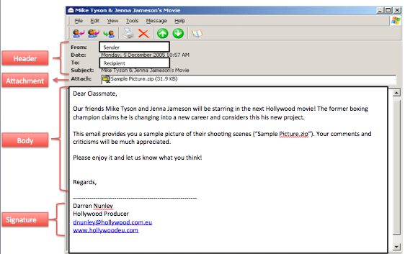
Communication Methods
Email, or Electronic Mail, is an important part of communication within businesses and should be used effectively. An email is made up of two parts – the header and the body The email message header usually contains:
From: – the email address of the sender
To: – email address(es) of the recipient
Subject: – brief summary of email contents
Date: – time and date the email was sent
Attachment: – where attached files are shown
The body is where the actual content of the email is written.
For emails to be used effectively all parts of the header and body should be filled out appropriately. To ensure that SWS are using emails effectively they would like you to create a document in order to summarise the key features, purposes and uses of the information described above.
Email

Slide 7
Email Communication
LO3: How ICT can be used to support business working practices
SWS events would like you to create a document to discuss the features and purposes of computing devices.
Communication methods – Email
Subject line | The subject line is important to identify what the email is about and should always be included in emails. For example, if an estate agent was contacting a customer, “A House” would not be appropriate, whereas “House for sale - Oakley Vale Corby” would be. Emails with an appropriate subject line are more likely to be read and not seen as “junk mail” or spam.
To, CC and BCC | “To” is used to determine who will receive the email. “CC” stands for Carbon Copy and everyone in the CC line will receive an exact copy of the email sent. “BCC” stands for Blind Carbon Copy and works like the CC, except know one else that receives the email will know that it was sent to the person in the BCC line. An example of when to use BCC would be if a business wants to send information to many customers, but wants to keep their email addresses private from all of the other recipients.

Slide 8
Email Communication
LO3: How ICT can be used to support business working practices
SWS events would like you to create a document to discuss the features and purposes of computing devices.
Communication methods – Email
Attachments | Attachments are files sent with emails and increase the size of the email and will make it slower to send. Attachments could have viruses or spyware and should therefore be scanned before opening it. When businesses send emails with attachments it is important to ensure that customers have the software needed to view the attachment. Solutions could be using PDF files or including links to websites in the email body. It is always good practice to state in your email that there are attachments in case they are not received.
Signatures | Signatures are the text at the bottom of the email that allows you to know who sent it. Businesses should always have professional signatures and include details such as: Full name, function within the business, email address, contact number, etc.

Slide 9
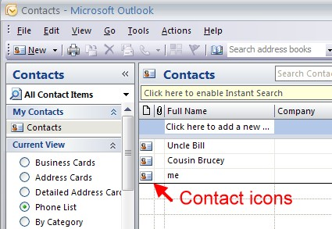
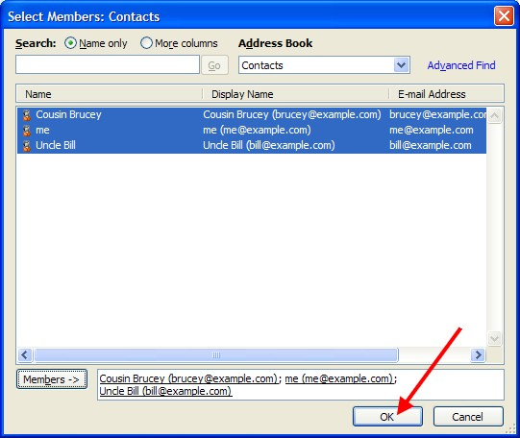
Email Communication
LO3: How ICT can be used to support business working practices
SWS events would like you to create a document to discuss the features and purposes of computing devices.
Communication methods – Email
Address Book | Extremely important for businesses and store customer details such as email addresses, mobile numbers, etc. Businesses would use this to contact customers about special offers, advertising, etc. Businesses could also create distribution lists which could be used to add customer email addresses in order to send them information.

Slide 10
Email Communication
LO3: How ICT can be used to support business working practices
SWS events would like you to create a document to discuss the features and purposes of computing devices.
Communication methods – Email
Etiquette | Rules or netiquette should be followed when sending emails – these include: use an appropriate subject line follow the agreed email policy within the business check the message content before sending the email include a signature on any business emails you should be polite messages should be written in plain English with careful use of abbreviations do not write the message in capital letters check if the email should be replied to all the sending list or just the person the email was originally from tell people the format of any attachments you send if they’re anything other than standard. For example, Microsoft Office file types.

Slide 11
Diary Management Software
Diary management software (DMS) is extremely useful to ensure staff all know when company meetings, etc. are. This also allows employees working remotely from the company to know when they need to be in and how well the project is progressing if they are working in a group situation. This software can be used to ensure meetings do not clash and even reminders can be set when calendars are shared across the organisation. Tasks that can be performed by DMS include:
Creating appointments/ meetings
Inviting participants
Creating tasks
Creating to-do lists
Setting reminders
To ensure that SWS are using diary management software (DMS) appropriately they would like you to create a document in order to summarise the key features, purposes and uses of the information described above.
Diary Management

Slide 12
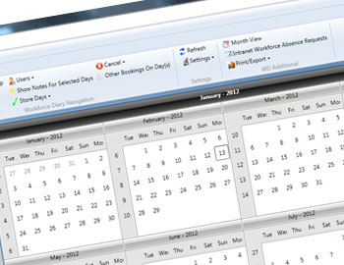
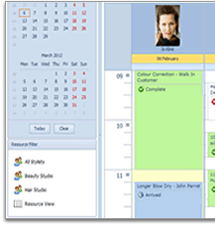
Diary Management Software
LO3: How ICT can be used to support business working practices
SWS events would like you to create a document to discuss the features and purposes of computing devices.
Communication methods – Email
Creating appointments/ meetings | DMS allows you to create appointments and meetings and will be able to show a list of the people coming. The DMS can even tell you if there are clashes and suggest alternatives times.
Inviting participants | Once the list has been created the DMS will be able to use email addresses to invite people to the meetings.
Creating tasks | A list of tasks can be created in the DMS software and can be used to track who is to complete each task and what the deadlines are for each of the tasks. DMS software allows tasks to be created by other people and control who has access to the lists.
Creating to-do lists | To-do lists are like tasks, but for smaller duties and usually used by individuals to track personal things that need doing such as appointments for the dentist, etc.
Setting reminders | Reminders can be set for tasks and can also be made to activate at different times prior to the appointment. For example, a day before or 30 minutes before the task.

Slide 13
Diary Management Software
LO3: How ICT can be used to support business working practices
SWS events would like you to create a document to discuss the features and purposes of computing devices.
Communication methods – Email
Cloud systems and APPs | Today DMS systems are cloud based and therefore can be accessed through web browser or smartphone. To use that DMS on phones or tablets a APP is needed. Because the DMS is on cloud all of the information is stored remotely which will help employees the are away from the company regularly. This will also help employees that work remotely as a group on a project, as they can see what tasks need to be done and what the deadlines for each are. Documents and files can also be sent using the DMS. Username and passwords can be created for DMS software to control what tasks can be seen.

