Slide 1
Designing Data Capture Forms
LO2: How to work with information and data to meet specific business needs
SWS events would like you to create a document to discuss the features and purposes of computing devices.
Designing Data Capture Forms
Things to consider when designing Data Capture Forms: Include examples of the data and spaces for the answers on paper-based forms. Include the right amount of spaces to help ensure that the correct data is collected. Include the type of data to be entered to reduce errors. Data like temperature should be collected as numbers and names as text.
The form on the left is not as good as the one on the right as the one on the right forces the user to separate their letters and numbers so that they are easier to read. It also provides set spaces for post codes, telephone area codes and tick boxes for male and female as there are limited answers and therefore easier to just tick.

Slide 2
What to DO when Designing Forms
LO2: How to work with information and data to meet specific business needs
SWS events would like you to create a document to discuss the features and purposes of computing devices.
Designing Data Capture Forms – Improving Online Forms
Online Data Capture Forms can be improved even more in the following ways: Include drop-down menus to force the user to select from a pre-set selection of choices. Use tick boxes to simplify the input of data – especially if there are multiple answers. Use radio buttons to ensure that users can only select one answer. When online do not use separate boxes for each letter like on an offline form. Use pre-set formats – for example all dates are entered as DD/MM/YYYY. Break information into smaller data – E.g. Address is: Number, Street, Town, County and Postcode. Use validation rules to make sure that data entered is correct.
Validation rules reduce errors when entering information as they check if the data entered is correctly according to a set rules, such as the right number of letters, numbers, no spaces, etc.
For example, it will not allow date that are not in the format DD/MM/YYYY or telephone numbers that are not (00000) 0000000. This ensures that data is entered correctly

Slide 3
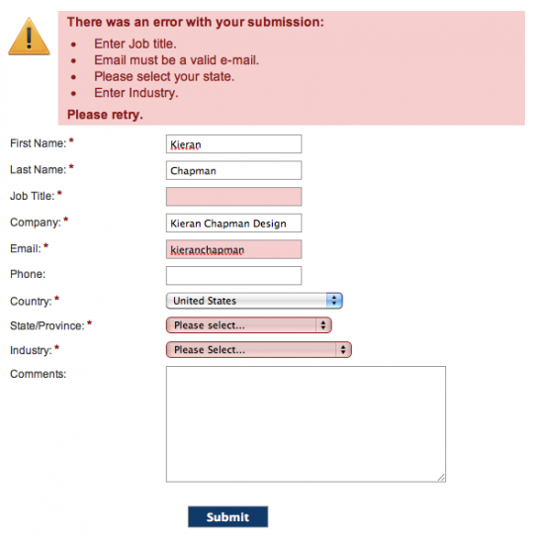
What to AVOID when Designing Forms
LO2: How to work with information and data to meet specific business needs
SWS events would like you to create a document to discuss the features and purposes of computing devices.
What to AVOID when Designing Online Forms
Things NOT to do when designing online data forms: Do not make the font too small so that it cannot be read. Do not make input boxes too small – E.g. 4 spaces for post code when 8-10 are needed. Do not ask vague questions like “what do you like best?” Not specifying the input format as an empty line for date of birth could typed in many ways. Do not use ranges that overlap as this is confusing – E.g. 0-5, 5-10, 10-15.

Slide 4
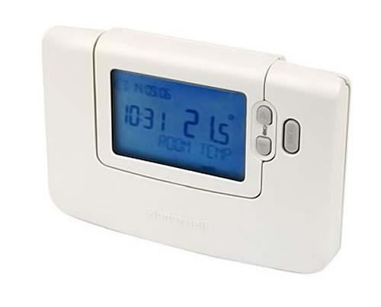
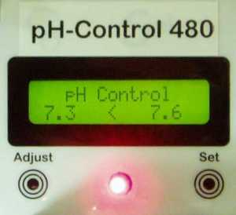
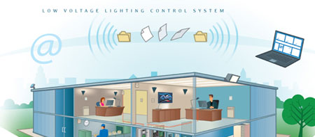
Automatically Collecting Physical Data
LO2: How to work with information and data to meet specific business needs
SWS events would like you to create a document to discuss the features and purposes of computing devices.
Automatically Collecting Physical Data
Temperature | Measuring the temperature in a room or controlling the heat of a swimming pool can all be done through sensors.
pH | To keep water clean data such as PH readings can be automatically collected in water quality control systems.
Light | Lighting systems can collect data automatically so that lights can be managed effectively and efficiently.
Pressure | Pressure sensors are often used to find out if someone is in a specific area, such as those used in alarm systems.

Slide 5
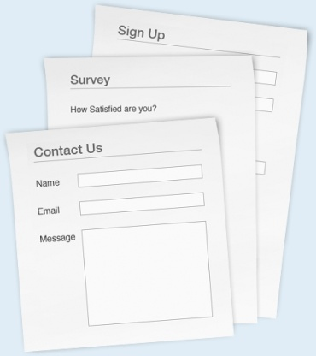
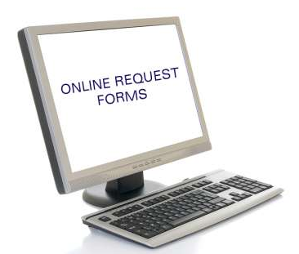
Choice of Data Collection Methods
LO2: How to work with information and data to meet specific business needs
SWS events would like you to create a document to discuss the features and purposes of computing devices.
Choice of Data Collection Methods
Nature of data to be captured | The nature of the information that you are going to be collecting will influence the data needed. For example Names, Addresses and Postcodes are all text and height and weight will be collected as a number data type. On top of this, sometimes online is better than offline (paper based) methods. For example, collecting information for new members joining a large retail store would be easier online, but collecting information for new gym members at a local leisure centre, would be easier through offline (paper based) methods.
Location of information | If data collection is in extreme locations then automatic could be better than paper-based. For example readings of a volcano could be done automatically. Sometimes automatic is also better just to free up employees so that they can do other work.
Cost and availability | Cost also affects data collection as paper based methods are cheaper than setting up websites, etc. Therefore some companies will go paper based for this reason.

Slide 6
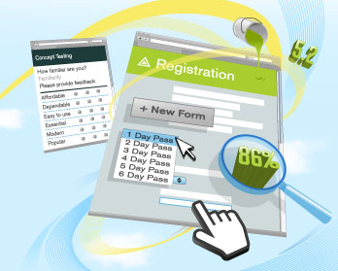
Choice of Data Collection Methods
LO2: How to work with information and data to meet specific business needs
SWS events would like you to create a document to discuss the features and purposes of computing devices.
Choice of Data Collection Methods
Ease of use | Paper based is easy to use for many people, but bad handwriting could make it difficult to read. Data on the sheet could also be left incomplete and errors made when entering the information. Online forms are much easier to use in these respects as it is easy to read and data entered can limited through rules and check and tick boxes.
Analogue to digital convertor | When sensors record information (heat, light, pH, etc) they can change it from analogue to digital so that computers can understand the information. This is done with a analogue to digital convertor.
Data security | Information about people must be kept secure. This means that it cannot be lost, damaged, changed so that it is inaccurate or used for the wrong reasons (such as fraud). Rules covering this are in the Data Protection Act. To protect data backups should be made, passwords should be used and encryption enabled to prevent unauthorised people accessing the information.

Slide 7
Choice of Data Type
LO2: How to work with information and data to meet specific business needs
SWS events would like you to create a document to discuss the features and purposes of computing devices.
Data Type | Description | Example | Typical Use
Text | Any Character | Hello @! 123 | Names of people, address, telephone numbers (this is text as it can have spaces!)
Integer Number | Whole Numbers | 1234 | Number of items in stock or items sold
Real Number | Any number with or without decimal places | 10.50 | Prices, height, weight
Date | Stores a date in various formats | 10/08/2012 | For dates in various formats, e.g. 10/08/12 or 10 August 2012, etc
Boolean | True or False | When there are choices between two options, Y/N, True or False | Enter whether customers have paid or if they are vegetarian
Image | A graphic file | A photograph | A customer membership photo

Slide 8
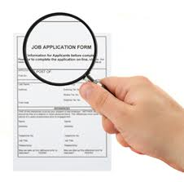
Data Verification Methods
LO2: How to work with information and data to meet specific business needs
SWS events would like you to create a document to discuss the features and purposes of computing devices.
Data Verification Methods
Verification | Verification is used to ensure that data entered into the system is the same as that on the form. For small amounts of data a visual check is enough, but for large amounts two people can enter the same data and the computer can check this and report any problems to the people entering the data. Other ways of doing this is by using double input – for example, entering a password, where the user is asked twice to enter the data to insure it is correct.

Slide 9
Data Validation Methods
LO2: How to work with information and data to meet specific business needs
SWS events would like you to create a document to discuss the features and purposes of computing devices.
Data Validation Methods
Validation | Validation checks to see if the data entered is correct as the user enters it into the system. Validation rules are used in spreadsheets and databases to check that data is entered correctly. There are various types of validation checks: Presence check – This checks to see that all required data is entered and not left blank. Data type check – This checks that if numbers are required, then only numbers are entered. Format check – This ensures that data is entered correctly, for example: DD/MM/YYYY Range check – This checks that data is in a set range, for example age > 18 and < 60 Character check – This checks that incorrect characters are not entered, for example there are no @ or ! in a post code.

Slide 10
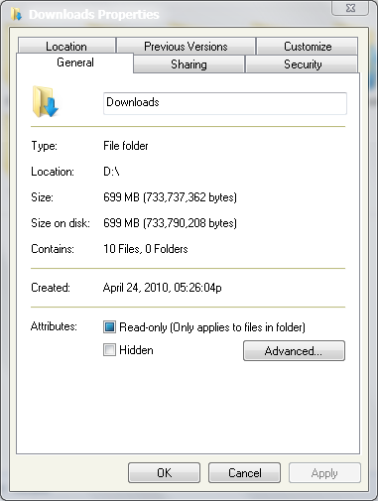
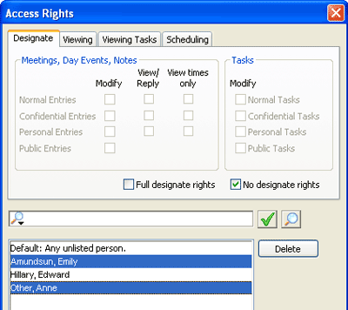
Network and Computer Security
LO2: How to work with information and data to meet specific business needs
SWS events would like you to create a document to discuss the features and purposes of computing devices.
Data Security Methods
Network and computer security: Usernames and Passwords Access Rights and Permissions | All staff need to be given appropriate usernames and passwords so that they cannot access sensitive data. Along with this each member should also have different access rights and permissions so that employees will not have access to data unless granted clearance. Files and folders can also be protected by making them read-only so that information is not deleted.

Slide 11
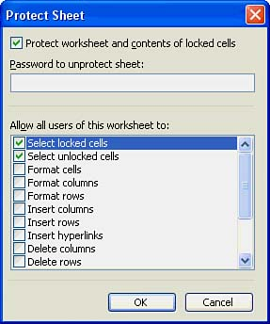
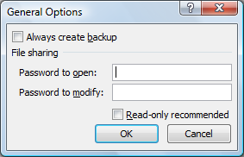
Document Security - Passwords
LO2: How to work with information and data to meet specific business needs
SWS events would like you to create a document to discuss the features and purposes of computing devices.
Data Security Methods
Document security: Passwords | Sensitive documents on computers can also be password protected so that they cannot be accessed. Read-only passwords allow users with the correct password to only view and not edit the files. Open/Modify passwords allow uses to edit the files. In files like spreadsheets sheet protection can also be used to stop people editing data in the spreadsheet.

Slide 12
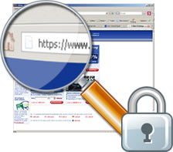
Document Security - Encryption
LO2: How to work with information and data to meet specific business needs
SWS events would like you to create a document to discuss the features and purposes of computing devices.
Data Security Methods
Document security: Data Encryption | Sometimes passwords for documents can be found and in these cases data encryption is necessary. Data encryption uses an encryption code/key to encrypt the document and then the receiver will use the same code/key to decrypt the file. If the wrong key is used then the data is meaningless. Businesses should always use encryption to secure details about customers and the business. On the internet encryption is also used when you enter your email address, passwords, payment details, etc. This is usually shown by https and a small padlock at the top of your web browser.

Slide 13
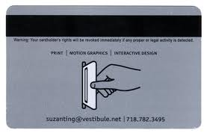
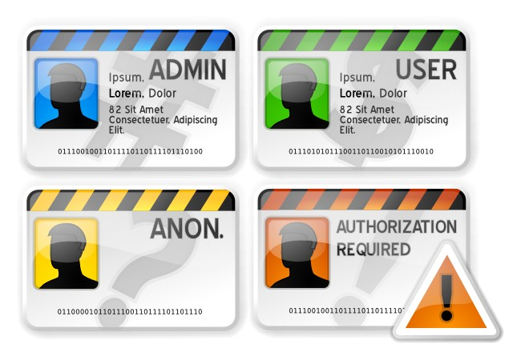
Physical Security
LO2: How to work with information and data to meet specific business needs
SWS events would like you to create a document to discuss the features and purposes of computing devices.
Data Security Methods
Physical security: Security Badges Locking doors, window security bars, etc. | Offices uses security guards to monitor data security and prevent unauthorised access. RFID tags can also be placed into security badges and cards which allow staff to enter areas only if they have the appropriate clearance. Other security includes not having computers on the ground floor where they are easily accessed. Ensuring that windows have bars, or strengthened glass and doors are thick and strong, etc.

Slide 14
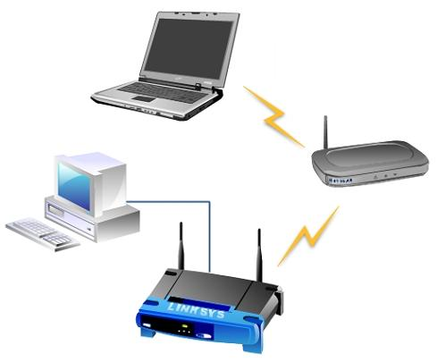
Data Transferring Technologies
LO2: How to work with information and data to meet specific business needs
SWS events would like you to create a document to discuss the features and purposes of computing devices.
Data Transferring Technologies
Wired Methods | Wired methods connect computers together with cables and are therefore faster and reliable. They are also more difficult for hackers to access but are, however, more expensive and difficult to install.
Wireless Methods | Wireless methods use WAPs to connect wireless devices such as smartphones, laptops, tablets, etc. They allow portable data transfer but not as secure as wired connections.
Mobile Data Transmission | 3G and 4G communication allows mobile phones to connect to the Internet. 4G has a high bandwidth is faster than 3G. Mobile transmission is expensive as tariffs are high.

Slide 15
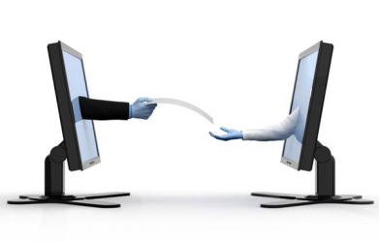
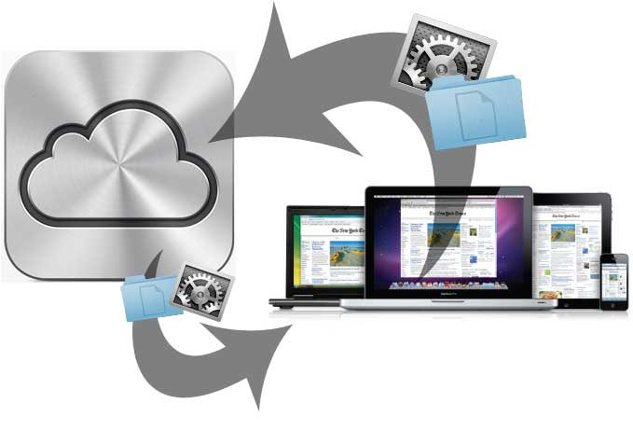
Data Transferring Technologies
LO2: How to work with information and data to meet specific business needs
SWS events would like you to create a document to discuss the features and purposes of computing devices.
Data Transferring Technologies
Remote Methods | Email – this is used by employees to transfer data no matter where they are. Emails are unsecure though and hackers can access information and files sent. File Sharing – Also know as peer-to-peer, this allows people to upload and share files with each other on the Internet. This does however allow illegal sharing of files. Cloud – This stores company files on the Internet to be accessed anywhere. The company offering the cloud storage is also responsible for the data security which is good, but you pay a lot of money for Internet space.
File Compression | File compression allows you to “shrink” (compress) the size or the file so that it can be easily transferred by email or over the Internet. This also helps devices such as mobiles which have to transfer files over a low bandwidth. Compressing audio and video files can help save space and make file transfer quicker, but the more compressed they are the lower the sound and video quality.

Slide 16
Data Transferring Technologies
LO2: How to work with information and data to meet specific business needs
SWS events would like you to create a document to discuss the features and purposes of computing devices.
Data Transferring Technologies
Factors affecting the Choice of Method | USB flash drives are usually affordable and quick for transferring files between computers, work and home. Unfortunately they can be easily lost so data is unsecure. CDs and DVDs are not as big as flash drives and it takes a long time to write data to them using a CD/DVD writer. Emails are useful for transferring small files, but not secure and therefore files should be encrypted. For wired and wireless data transfer, speed and bandwidth are important, especially when transferring large files such as videos. Wired methods are therefore usually quicker more suited to large files. 3G and 4G wireless data transfer for mobiles can stream videos, but it usually takes long to process big files.

Slide 17
Data Backup and Recovery
LO2: How to work with information and data to meet specific business needs
SWS events would like you to create a document to discuss the features and purposes of computing devices.
Data Backup and Recovery
Data Storage Media | If you need to backup huge amounts of data then CDs/DVDs and USBs are not suitable. CDs and DVDs also have the problem that you will need many of them and therefore piles of CD/DVD backups is usually a problem. CDs/DVDs and USBs have the advantage that they can be kept away from the computer in case of fire, etc. In cases of large amounts of data companies can use tape drives or extra hard disks. Tape systems have large amounts of space but are expensive whereas hard drives are not as expensive. Cloud storage on the other hand is very useful for smaller companies that do not have much money. Cloud storage providers can also charge customers to provide security and data backup, but can be cheaper than doing it themselves.

Slide 18
Data Backup and Recovery
LO2: How to work with information and data to meet specific business needs
SWS events would like you to create a document to discuss the features and purposes of computing devices.
Data Backup and Recovery
Backup Frequency | Most businesses will backup data after every work day, usually at night when staff are not using the system. Bigger businesses will even backup more often, like banks that backup every few minutes.
Backup Recovery | A lost file can usually be recovered from a backup. A disk image can restore a whole hard disk but today most backup software can also allow you to select the specific file you are missing. How up-to-date the files you recover are, will all depend on the frequency of your backups.
Archiving | Collections of data that are backed up or “archived” as they are no longer needed in day-to-day operations. Once archives are made they can usually be deleted off the hard disk as they will be stored separately. Examples of archives, could be the sales and financial reports from last year, or student work from 2 years ago.

Slide 19
Data Backup and Recovery
LO2: How to work with information and data to meet specific business needs
SWS events would like you to create a document to discuss the features and purposes of computing devices.
Data Backup and Recovery
Automated versus Manual Systems | Most companies will backup frequently, such as the end of each day. To speed up the process they can choose to do this automatically, for example at 1am each morning. At other times due to how difficult the backup is it might require technical knowledge and so IT specialists would need to back each system up manually. Manual backups can also be useful if backup times change regularly or if backups are rarely made (for example in a small store).

Slide 20
Data Backup and Recovery
LO2: How to work with information and data to meet specific business needs
SWS events would like you to create a document to discuss the features and purposes of computing devices.
Factors affecting Choice of Method
Type | Cost | Ease of Use | Security
Tape | Expensive device and media | Tapes need to be replaced after each backup Tapes are easily damaged, e.g. fire | Data is encrypted Small so easily stolen
External Hard Disks | Relatively cheap for large amounts of space, e.g. 1TB | Connects via USB so easy to use if the devices have USB | Data can be encrypted Small so easily stolen
CDs and DVDs | Cheap unless large amounts of backups are needed | Small amount of space and therefore needs to be changed during backups | Data can be encrypted Small so easily stolen
USB Flash Drive | Very cheap to buy | Will work on any device with a USB Most smartphones and tablets do not have USB | Most USBs have software that will secure the drive with a password Small so easily stolen
Cloud Storage | Expensive for small amounts of space | Easy to use once setup and can be accessed from anywhere with the Internet | Data security is the responsibility of the cloud provider and therefore helps smaller businesses.

