Slide 1
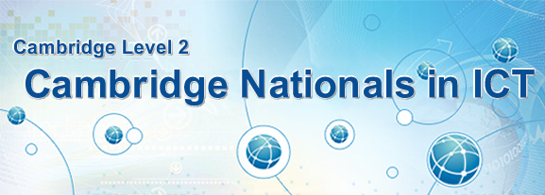
Welcome
Unit 1 – Understanding Computer Systems
ICT Dept

Slide 2
Assignment Scenario
Assignment
LO1
SWS Events is a company that specialises in organising various sporting, cultural and leisure activities for the managers and employees of other corporate companies. Within the company SWS uses various computer systems in order to manage accounts, book events, calculate prices, etc. To be successful SWS employs various men and woman in their call centre, sales team, marketing and finance departments, etc. This requires all staff to have a good understanding of current technologies and computer systems. In order to keep staff up to date and in contact with each other, SWS therefore uses various technologies such as desktop computers, laptops, smartphones and tablets. To save money and improve customer service, SWS also uses computers to:
Store event prices, information and customer details.
Send information to clients through the Internet, Email and Mobile messaging services.
Communicate with staff and customers through video conferencing and applications.
Protect customer information through server security, door locks and access codes.
To ensure that SWS is using the best possible technology and computers they would like you to create a document in order to discuss the features and purposes of computing devices. Within this document they would also like you to make recommendations on the technology and computers to use given the situations described.

Slide 3
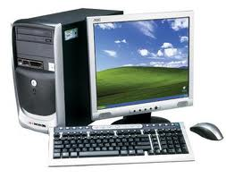
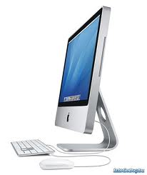
Desktop Computers
LO1: Understand how ICT can be used to meet business needs
SWS events would like you to create a document to discuss the features and purposes of computing devices.
Desktop Computers | Purposes or Use
A desktop computer is a personal computer (PC) that is generally used in the same location all the time and cannot be moved as easily as laptops and portable computers. Desktop computers come in a variety of types such as vertical tower cases, horizontal tower cases and even some that can fit behind a computers LCD monitor (screen). Desktop computers should sit on a large desk that is secure and could be secured to a steel bracket for security. These desktops will have various inputs and outputs such as a keyboard, mouse and monitor. If they are connected to a network it will usually be with a network cable plugged into the back of the computer. | Desktop computers are usually used for: High end graphic or movie editing Music and Audio editing General tasks such as Word Processing, Spreadsheets and Databases. Writing letters, reports, memos and/or agendas. Surfing the Internet and/or creating websites.

Slide 4
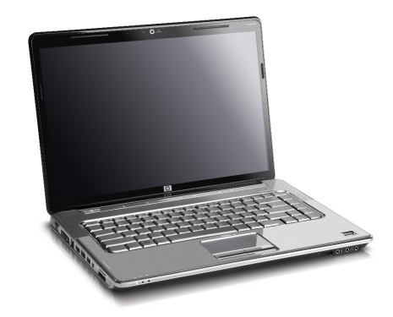
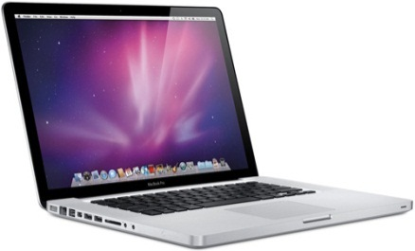
Laptop Computers
LO1: Understand how ICT can be used to meet business needs
SWS events would like you to create a document to discuss the features and purposes of computing devices.
Laptop Computers | Purposes or Use
A laptop is portable unlike a desktop computer because it is smaller in size and lighter in weight. Input and Output devices such as the keyboard, mouse and monitor are built in unlike the desktop. Other devices can be connected to the laptop by using the USB port. Laptops can be powered by the mains or battery which makes it portable. Most last around 4 hours, but new laptops such as the Apple Macbook can last 10 hours. The fact that laptops are easily moved around makes them easy to damage and steal. | Laptops can be used to surf the Internet and connect to different networks wirelessly. Because of this it is easy to use laptops when away from work and/or home. Laptop computers are usually used for: Basic graphic, music and/or movie editing. General tasks such as Word Processing, Spreadsheets, Databases, surfing the Internet and/or creating websites. Sending emails, messages, video conference (Skype), DTP, presentations, etc.

Slide 5
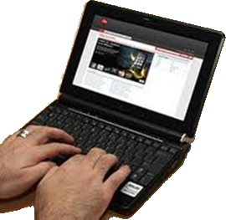
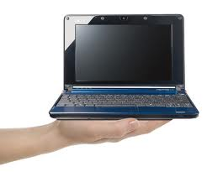
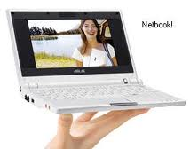
Netbook Computers
LO1: Understand how ICT can be used to meet business needs
SWS events would like you to create a document to discuss the features and purposes of computing devices.
Netbook Computers | Purposes or Use
A netbook computer is even smaller and lighter than a laptop and can be easily used when travelling on aircraft, trains, etc. Input and Output devices such as the keyboard, mouse and monitor are built in unlike the desktop. Other devices can be connected to the netbook by using the USB port. Netbooks usually have lower specifications when compared to desktops and laptops. They usually have less memory also which means that software might run slowly or not at all. CD or DVD drives are usually connected by USB as the Netbook is to small to have these built in. Netbooks can be powered by the mains or battery which makes them portable, but also easy to damage and steal. | Netbooks can be used to surf the Internet and connect to different networks wirelessly. Because of this it is easy to use netbooks when away from work and/or home. Reduced specifications, however, means they run software and applications slowly or not at all. Netbook computers are usually used for: General tasks such as Word Processing, Spreadsheets, Databases, surfing the Internet and/or creating websites. Sending emails, messages, video conference (Skype), DTP, presentations, etc.

Slide 6
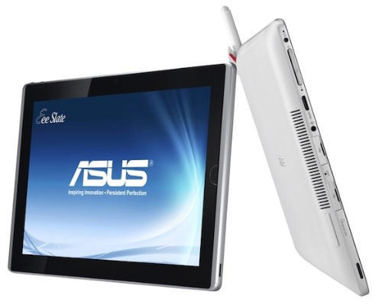
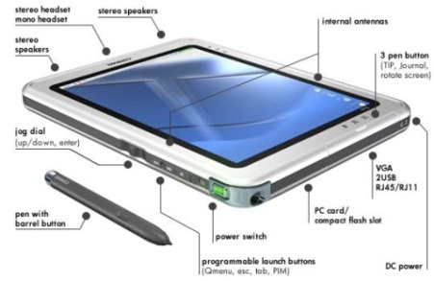
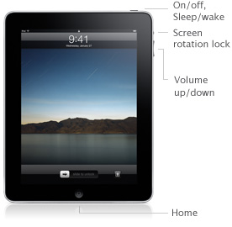
Tablet Computers
LO1: Understand how ICT can be used to meet business needs
SWS events would like you to create a document to discuss the features and purposes of computing devices.
Tablet Computers | Purposes or Use
A tablet computer is even smaller than netbook and laptops and usually do not have a keyboard or mouse as they have touch screens. These touch screens usually show content as well as responding to gestures or finger swipes (e.g. to increase image/text size). Applications or Apps can also be run on these tablets and take memory to run. It is more difficult to add Input and Output devices to these tablets unless they are wireless or bluetooth. Tablets use solid state memory usually in sizes of 16gb or 32gb and therefore cannot contain to many apps and data. Tablets are powered by battery which makes it portable and also easy to damage and steal. | Tablets are very useful when surfing the Internet and can use WiFi hotspots when you are travelling (e.g. McDonalds free WiFi or The Cloud). Since tablets are small they can be easily transported and SIM cards can also be added so that they are always connected to the Internet. General tasks such as Word Processing, Spreadsheets and Databases are limited at the moment because of application and space limitations. Tablet computers are currently used for: Sending emails, messages, video conference (Skype), browsing the Internet, viewing images, etc.

Slide 7
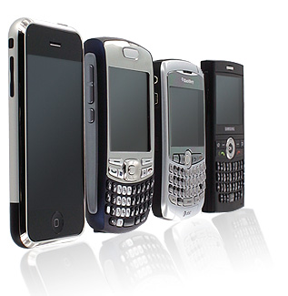
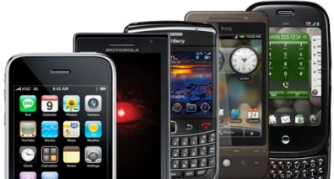
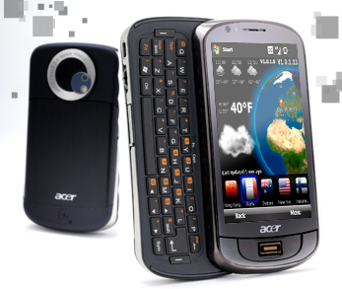
Smartphones
LO1: Understand how ICT can be used to meet business needs
SWS events would like you to create a document to discuss the features and purposes of computing devices.
Smartphones | Purposes or Use
A smartphone is a portable or mobile computer that usually has solid state memory in the sizes 8mb, 16mb, 32mb or 64mb. Like tablets, most smartphones usually have touch screens and also respond to gestures or finger swipes. These smartphones can be used as a phone, to send messages, surf the Internet, run applications, etc. Most smartphones also contain a digital camera for still images and videos and a media player for music and audio. Today they also contain GPS devices which allow phones to be tracked and use apps such as Google Maps. Smartphones are powered by battery which makes them portable but also easy to damage and steal. | Smartphones can be used to surf the Internet and connect to different networks wirelessly. Because of this it is easy to use smartphones when away from work and/or home. Smartphones are usually used for: General tasks such as surfing the Internet , viewing maps, GPS, etc. Phoning friends or work colleagues, Sending text messages, Sending emails, Video conference (FaceTime / Skype), Business functions as a PDA (Personal Digital Assistant) and diary, Running apps (applications).

Slide 8
Advantages and Disadvantages
LO1: Understand how ICT can be used to meet business needs
SWS events would like you to create a document to discuss the features and purposes of computing devices.
Devices | Advantages | Disadvantages
Desktop | High specification and relatively easy to upgrade Adjustable height, monitor, etc. Large monitor | Not portable Takes up a lot of space
Laptop | Portable and lightweight Input and output devices included Runs off battery and uses WiFi | Easily damaged/dropped Can be easily stolen Battery life not always good Difficult to repair/upgrade
Netbook | Extremely portable due to size Battery lasts a long time Can use WiFi for the Internet | Low specifications Easily stolen Difficult to repair/upgrade Usually does not have CD/DVD player

Slide 9
Advantages and Disadvantages
LO1: Understand how ICT can be used to meet business needs
SWS events would like you to create a document to discuss the features and purposes of computing devices.
Devices | Advantages | Disadvantages
Tablet | Extremely portable due to size Battery lasts a long time Good for web browsing and uses WiFi and 3G Can get APPs to improve use | Limited Office tasks such as Word/DTP as APPs limited Touch screen difficult to use and bad visibility in daylight Limited connectivity to flash drives, CDs, DVDs, etc. Limited upgrade Easily damaged or stolen
Smartphone | Small, light and portable Can get APPs to improve use Excellent for communication Good for web browsing and uses WiFi and 3G | Limited Office tasks such as Word/DTP as APPs limited Touch screen difficult to use and bad visibility in daylight Limited connectivity to flash drives, CDs, DVDs, etc. Limited upgrade Easily damaged or stolen

Slide 10
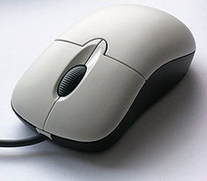
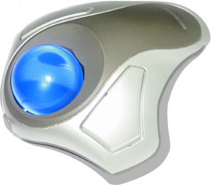
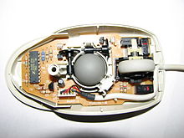
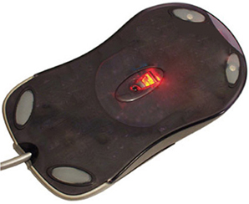
Input – Mouse
LO1: Understand how ICT can be used to meet business needs
SWS events would like you to create a document to discuss the features and purposes of computing devices.
Features | Purpose or Use
The features include: A mouse is seen on the screen as a pointer and usually uses one or more buttons to click on items. A trackball is a type of mouse, but the ball is found on the top and is particularly easy to use for those with limited movement in their hands. Typically a mouse can be either wired or wireless, with a wireless mouse being connected via Bluetooth. Originally a mouse contained a ball in order to make the pointer move, but today most new models work through optical or infra-red light. | The purposes include: To navigate around a desktop, laptop and/or netbook. The uses include: To select, drag, and run various software/apps. Trackballs are extremely useful to help people with motor dysfunction.

Slide 11
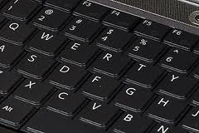
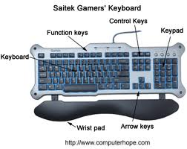
Input – Keyboard
LO1: Understand how ICT can be used to meet business needs
SWS events would like you to create a document to discuss the features and purposes of computing devices.
Features | Purpose or Use
The features include: Keyboards are generally keys labelled with letters and numbers, and usually set out in a way that they are easy to reach with your fingers. The most common keyboard layout is known as QWERTY. Keyboards can cause RSI (Repetitive Strain Injury) when over used and different supports can be used to help prevent wrist damage. When using keyboards it is important to keep your wrists straight and use them at the correct high so that you do not slouch or strain your muscles. To save time most keyboards have function keys and also shortcuts to reduce volume, brightness, etc. | The purposes include: To enter characters and numbers into a document such as writing a letter for a business purpose. Keyboard shortcuts can also help people with disabilities and help people interact with their Operating Systems (e.g. Windows 7). The uses include: To type letters, PowerPoint's, etc. Enter customer information into databases and spreadsheets. Help people with disabilities or reduce RSI through Sticky Keys or keyboard shortcuts such as Ctrl-P to print, etc.

Slide 12
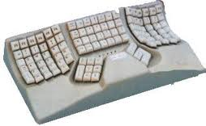
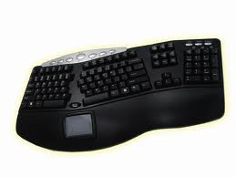
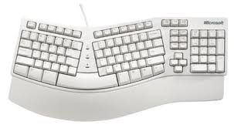
Input – Specialist Keyboard
LO1: Understand how ICT can be used to meet business needs
SWS events would like you to create a document to discuss the features and purposes of computing devices.
Features | Purpose or Use
The features include: These keyboards are like ‘normal keyboards’ but are either colour coded and set out in a different pattern or include raised marks such as braille so that visually impaired people can feel the keys. These keyboards can also be adjusted so that they reduce RSI and other injuries by ensuring that your wrist remains straight when typing – such as the Microsoft ergonomic keyboard. | The purposes include: To enter special characters not found on normal keyboards. To help visually impaired people with braille. To reduce RSI and other injuries. The uses include: To help people with various visual and/or motor dysfunctions. To use in specialist environment such as engineering. To help people who type all day long reduce computer related injuries.

Slide 13
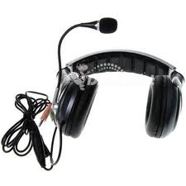
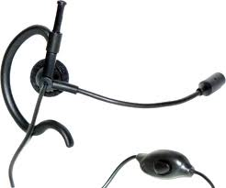
Input – Microphone
LO1: Understand how ICT can be used to meet business needs
SWS events would like you to create a document to discuss the features and purposes of computing devices.
Features | Purpose or Use
The features include: A microphone converts analogue sound into digital data that computers can use to record and playback. Microphones are useful where there is a high level of noise and business people need to communicate effectively. People with disabilities can use microphones to interact with their Operating System such as Windows 7. Software exists today that also allows people to speak and their words are typed for them (text to speech). Smartphones have APPs like Siri that can be communicated with like a person in order to perform functions. | The purposes include: To communicate with people and/or software in order to type text or perform functions. People with disabilities and motor dysfunction can use microphones to improve computer use. The uses include: Receptionists can convert speech to text to save time and reduce RSI. People with disabilities can control Operating Systems and software. Business people can speak to people or video conference. People with hearing problems can use Apps on phones like Siri.

Slide 14
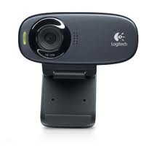
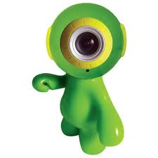
Input – Webcams
LO1: Understand how ICT can be used to meet business needs
SWS events would like you to create a document to discuss the features and purposes of computing devices.
Features | Purpose or Use
The features include: Webcams allow you to record video and store them on your computer. Common webcam qualities are 1, 2 and 4 Megapixels, but the higher the Megapixel the slower the streaming over the Internet. Today most laptops and computers like the iMac include built in webcams. Webcams that are not built-in are usually connected to computers using a USB cable. | The purposes include: To create resources for work such as tutorials. To record video for storage or uploading to the Internet, e.g. YouTube. The uses include: To video conference using Skype, MSN, etc. Can be used by teachers to record lessons or business people to record meetings or instructions.

Slide 15
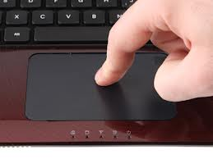
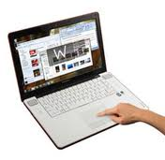
Input – Touch Pads
LO1: Understand how ICT can be used to meet business needs
SWS events would like you to create a document to discuss the features and purposes of computing devices.
Features | Purpose or Use
The features include: Touch pads are sensitive pads that respond to finger movements. These are commonly used in laptops and moving your finger will move the mouse and tapping on the pad will click on the object. Most new touch pads also have an area on the right to scroll up and down documents by swiping your finger up and down. | The purposes include: To be used as a mouse to make finger movements control the pointer on the screen. These can help people with reduced motor functions as they require less movements than a mouse. The uses include: To replace the need for a mouse on laptops and other devices that do not have much space available.

Slide 16
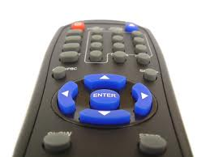
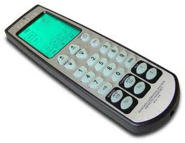
Input – Remote Controls
LO1: Understand how ICT can be used to meet business needs
SWS events would like you to create a document to discuss the features and purposes of computing devices.
Features | Purpose or Use
The features include: These are wired or wireless devices that use infrared to communicate with TVs, wheels chairs, etc. Most remote controls work off batteries and ‘All-in-One’ controls can be purchased to control multiple devices at once. | The purposes include: To send instructions to computer systems and/or computers. To control CD/DVD players and TVs for presentations, etc. The uses include: To control training sessions in businesses for customers and staff. In specialist environments to control robots and control systems. To control air-conditioning and/or temperature, etc. in leisure centres, etc.

Slide 17
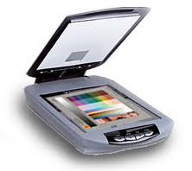
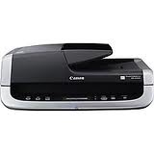
Input – Scanners
LO1: Understand how ICT can be used to meet business needs
SWS events would like you to create a document to discuss the features and purposes of computing devices.
Features | Purpose or Use
The features include: Scanners use light to capture images and/or documents in order to store them on the computer. Scanners can save these in multiple formats including JPEG and PDF. Scanners also include OCR (Optical Character Recognition) in order to take written documents and convert them into a format that can be edited in software like Microsoft Word. Flatbed scanners can only scan, while multi-function scanners can usually scan, print, copy and even fax. | The purposes include: To capture images and/or documents to save the time or keep records. To use OCR in order to save the time of typing documents out. The uses include: Businesses could use them to save records of sales, purchases, etc. Scanners can be used to make copies of information for customers. Lecturers could use scanners to make documents available for editing.

Slide 18
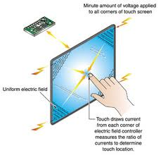
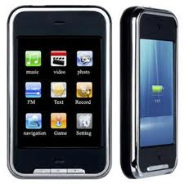
Input – Touch Screen
LO1: Understand how ICT can be used to meet business needs
SWS events would like you to create a document to discuss the features and purposes of computing devices.
Features | Purpose or Use
The features include: A touch screen has a touch sensitive display that responds to movements and gestures made by touching or swiping fingers across the screen. Touch screens have features such as gesture response which would zoom in, for example, if a user separates their fingers on the screen. Some people and those with disabilities might find using a touch screen difficult. | The purposes include: To enter characters, click on objects or interact with applications on device where a keyboard and mouse is not suitable, e.g. a smartphone. To enable people to have direct interaction with the objects on the screen. The uses include: These are used on smartphones and/or tablets to interact with the applications. These can be used in shops and/or shopping centres so that people can find products or directions easily.

Slide 19
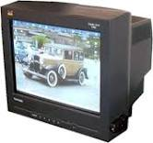
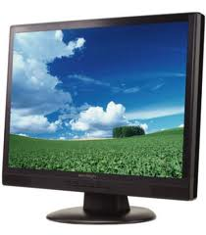
Output – Monitor/Screens
LO1: Understand how ICT can be used to meet business needs
SWS events would like you to create a document to discuss the features and purposes of computing devices.
Features | Purpose or Use
The features include: Used to show information from a computer on a screen. Old monitors used to be called CRT and were generally quite bad for your eyes. New monitors come in LCD and LED format and have high resolutions that make the HD (High definition). High definition 1080p resolution is equal to 1920 x 1080 pixels per inch which is approximately 2.1 Megapixels. | The purposes and uses include: Businesses could use monitors to show CCTV cameras. They can also be used to display presentations as well as the information that is being typed while using the computer.

Slide 20
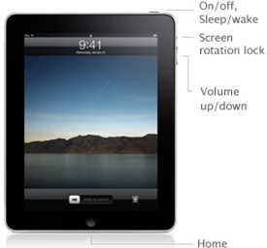
Output – Touch Screens
LO1: Understand how ICT can be used to meet business needs
SWS events would like you to create a document to discuss the features and purposes of computing devices.
Features | Purpose or Use
The features include: Touch screens have the same function as any other monitor, however they can also be used as an input in devices such as tablets and smartphones. | The purposes and uses include: Businesses would use touch screens to output information to customers in stores or shopping centres. Employees will also use outputs on touch screens, such as tablets and smartphones, to give information to other employees and/or customers.

Slide 21
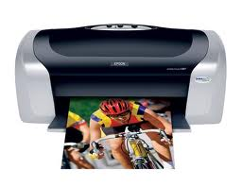
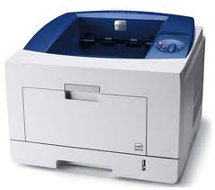
Output – Printers
LO1: Understand how ICT can be used to meet business needs
SWS events would like you to create a document to discuss the features and purposes of computing devices.
Features | Purpose or Use
The features include: Printers print a hard copy of the information stored on a computer. There are various types of printers including laser printers and ink-jets. Ink-jets spray the ink onto the page, while laser printers project the image to be printed onto a drum and then pass the paper over this. | The purposes and uses include: Businesses can use printers to print advertisements, receipts, membership cards, etc. Laser printers produce large volumes of work quickly and are generally cheaper to run. Ink-jet printers can print high quality colour prints, but are usually more expensive to run.

Slide 22
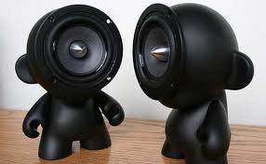
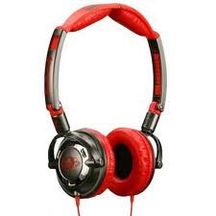
Output – Speakers, Ear/Headphones
LO1: Understand how ICT can be used to meet business needs
SWS events would like you to create a document to discuss the features and purposes of computing devices.
Features | Purpose or Use
The features include: These devices produce sound. Speakers are good for large audiences, while ear/headphones allow the user to listen to sounds even when in a noisy environment. | The purposes and uses include: Businesses could use these to video conference with speakers used for a large audience or ear/headphones when one-to-one contact is required. People can also use these to listen to audio, music, tutorials, etc.

Slide 23
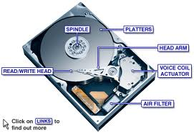
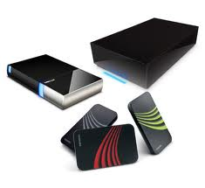
Storage – Hard Drives
LO1: Understand how ICT can be used to meet business needs
SWS events would like you to create a document to discuss the features and purposes of computing devices.
Features | Purpose or Use
The features include: They use magnetic disks to store software, music, videos and other files. The disks inside the drives are circular and spin at high speeds while heads read and write information. If hard drives are moved suddenly they can be damaged. Files on hard drives can be read, written, deleted and re-written. These drives storage huge amounts of data such as: 250GB, 500GB, 1TB, etc. Today these drives are portable and can be connected to computers by USB. | The purposes and uses include: Storing the operating system Storing of the files, software, music, videos, etc. Hard drives can store data, files and software even when the computer is turned off. Business could use hard drives to store a database of the details of members. Employees could use portable hard drives to save work when at home.

Slide 24
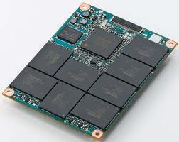
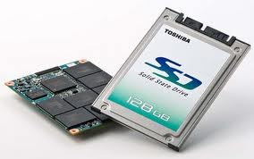
Storage – Solid-State Drives
LO1: Understand how ICT can be used to meet business needs
SWS events would like you to create a document to discuss the features and purposes of computing devices.
Features | Purpose or Use
The features include: Solid-state drives use memory to save software, APPs and files. There are no moving parts in these drives and are faster and more reliable than hard drives. These types of drives are common in tablets and smartphones as they are small and can hold 8GB, 32GB, 64GB and even 128GB of data. Because they are small they are very portable, but not as big as hard drives. | The purposes and uses include: Storing operating systems such as iOS 5 on the iPhone/iPad. They can store software, APPs and files even when not turned on. Business would use these if employees are likely to damage portable hard drives. Employees might use these if they have tablets and smartphones.

Slide 25
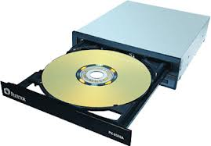
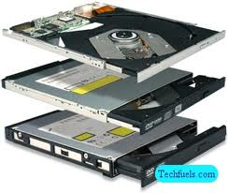
Storage – Optical Devices
LO1: Understand how ICT can be used to meet business needs
SWS events would like you to create a document to discuss the features and purposes of computing devices.
Features | Purpose or Use
The features include: These drives use media such as CDs and DVDs to store software and files. If these drives can write to CDs they will have CD-R/RW on them and for DVDs they will have DVD-R/RW. Once written on, most CDs and DVDs are read-only, but RWs can be written on, deleted and re-written on a limited number of times. Today Blu-ray drives and disks can be found and store large amounts of data, bigger than CDs and DVDs. CDs, DVDs and Blu-rays are not as big as solid-state or hard drives however. | The purposes and uses include: Storage of files to be move to another computer or played on CD/DVD/Blu-ray players. These are usually used to store software to be installed on computers, e.g. OS, Office, etc. These are also common when making backups of files and software. Business would use these to install software or make backups. Employees could use these to transport information to customers.

Slide 26
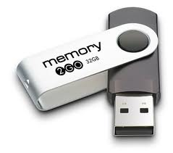
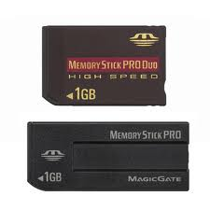
Storage – Flash Memory Drives
LO1: Understand how ICT can be used to meet business needs
SWS events would like you to create a document to discuss the features and purposes of computing devices.
Features | Purpose or Use
The features include: These are small drives that use solid-state memory and are usually plugged into USB ports. These devices are extremely portable and come in sizes of 16GB, 32GB, 64GB, etc. They are very reliable as they have no moving parts and therefore do not break easily. Files on these drives can be read, written, deleted and re-written. | The purposes and uses include: They are usually used to copy files and data to for transportation between computers, or from work to home. Business would use these drives to share files with colleagues. Employees could use these drives to transport small amounts of work to and from home and to take presentations to other computers.

Slide 27
Storage – Cloud Storage
LO1: Understand how ICT can be used to meet business needs
SWS events would like you to create a document to discuss the features and purposes of computing devices.
Features | Purpose or Use
The features include: This facility is made available to people through storage on the Internet. This is really useful as it means that all of you files are available no matter where you are, or which computer you are using. This facility is usually expensive though as companies supply space to people around the world. | The purposes and uses include: Cloud storage is common for sharing files between staff. Cloud storage providers include Apple, Microsoft and Drop-Box. Business would use it to make important files available to employees even when they are at home. Employees could use this storage so that they have presentations and files available when visiting customers as all they need is the internet.

Slide 28
Connectivity – Wireless Access Point
LO1: Understand how ICT can be used to meet business needs
SWS events would like you to create a document to discuss the features and purposes of computing devices.
Features | Purpose or Use
The features include: Wireless Access Point (WAP) allows computers to connect to a network wirelessly usually with radio frequencies. Typical WAPs are limited by a distance of 103m and a client limit of about 30. | The purposes and uses include: Common uses of WAP include hotspots which are public connections to the network and Internet. Tablets and smartphones for example use WAP in order to connect to networks and the Internet.

Slide 29
Physical Impairment – Devices
LO1: Understand how ICT can be used to meet business needs
SWS events would like you to create a document to discuss the features and purposes of computing devices.
Devices | Purpose or Use
Puff-Suck Switch | When the user blows/sucks a switch is activated to select items on the screen or send commands to the computer (This is very good for motor dysfunction).
Braille Keyboard | People with visual impairment can use a Braille keyboard to feel which keys to use without seeing them.
Foot Mouse | One foot is used to press down the foot pad and the other is used to move the mouse on the screen.
Text-to-Speech Software | Visually impaired people can use this to have text on the screen read to them. Sounds can also be made to let them know they have done something.
Speech-to-Text Software | People with visual impairment or motor dysfunction can use this software to type text or perform actions for them.
Zoom | Visually impaired people can use this to zoom on areas with the mouse to see the clearly.
Puff-Suck Switch
Braille Keyboard
Foot Mouse
Text to Speech
Speech to Text
Zoom

Slide 30
Remote Working – Devices
LO1: Understand how ICT can be used to meet business needs
SWS events would like you to create a document to discuss the features and purposes of computing devices.
Devices | Purpose or Use
Remote Desktop Connections | Allows people to share other computer desktops by remote computers such as laptops. This appears as though you are using the desktop as if in the office and allows people to work remotely or lets network managers fix computers.
Virtual Private Network (VPN) | This allows you to connect different networks together so that they appear to be the same network. For example, a business with branches across the UK, can connect them all together with a Internet VPN.
File Transfer Protocol (FTP) | These are rules (protocols) that allow you to send and receive files over a network and the Internet.
Remote Desktop
VPN
FTP

Slide 31
Wired Peripheral Connections
LO1: Understand how ICT can be used to meet business needs
SWS events would like you to create a document to discuss the features and purposes of computing devices.
Wired Peripheral Connection Features and Uses
USB (Universal Serial Bus) | Standard way of connecting devices together. It allows fast data transfer and is usually used to transfer files between computers. Most peripherals also use USB to connect to a computer including digital cameras, scanner and printers.
FireWire | FireWire is similar to USB, but is much quicker and is commonly used to transfer large files like videos. FireWire hardware is expensive though and therefore not commonly used.

Slide 32
Wireless Peripheral Connections
LO1: Understand how ICT can be used to meet business needs
SWS events would like you to create a document to discuss the features and purposes of computing devices.
Wireless Peripheral Connection Features and Uses
Wi-Fi | Wireless connections (known as Wi-Fi) allow devices to connect to the computer without cables. Today many devices such as printers use Wi-Fi. These Wi-Fi connections are usually more complicated to setup and transfer data slower than wired connections.
Bluetooth | Bluetooth uses wireless technology to connect devices such as a mouse or mobile phone. Bluetooth connections are usually secured by using a key that must be entered on both devices. Bluetooth cannot send much data however and distance is limited. Common uses include sending information between devices on the go and connecting headsets or transferring files between mobile phones.
Infrared | Wi-Fi and Bluetooth devices do not need to be in line of sight with each other and can even work through walls. Infrared however requires devices to be very close (usually within 1m) and in sight or each other. Infrared is therefore more secure and usually transfers images quickly.

Slide 33
Wired Peripheral Connections
LO1: Understand how ICT can be used to meet business needs
SWS events would like you to create a document to discuss the features and purposes of computing devices.
Connecting to wireless networks
Speed of Data Transmission | Data transmission relates to the speed that videos, images, etc. load or transfer over a network and generally wireless networks are slower than wired.
Bandwidth | Bandwidth refers to the maximum amount of data that can travel along a network at once. If you have a low bandwidth then videos will take long to load and worst still, if there are a number of users then bandwidth gets used extremely quickly and the computer will drop out.
Wi-Fi | Wi-Fi is a trademark of the Wi-Fi Alliance and is often used to refer to a wireless network. Wi-Fi hotspots exist in cafes with a range of 20m for the public.
Service Set Identifier (Also known as SSID) | The SSID is a unique name given to a network so that users can identify it, e.g. BrookeWeston. All devices on must use the same SSID for the network to work. SSIDs can also be hidden to increase security if they do not want the public using the wireless network.
Public SSID | Network managers can set the SSID to public so that they can be made available for people near a WAP.

Slide 34
Wired Peripheral Connections
LO1: Understand how ICT can be used to meet business needs
SWS events would like you to create a document to discuss the features and purposes of computing devices.
Connecting to wireless networks
Security of Networks | Wireless networks are less secure as anyone in range can connect to it, whereas wired networks require cables. Data sent on wireless can also be intercepted and therefore they need encryption – usually in the form of a network key that is required by all devices.
WEP, WPA, WPA2, AES | All of these are used to secure data on networks. WEP (wired equivalent privacy) was first used and then followed by WPA, WPA2 (Wi-Fi protected access) and AES (advanced encryption standard), which are much more secure.
Remote Connections | Remote connections are extremely dangerous and routers, firewalls, user IDs and passwords must be setup so that hackers can not get information.
Firewalls | Firewalls are setup to prevent unauthorised users from accessing a network. This works by viewing all incoming and outgoing traffic and blocking suspicious ones.
User ID and Passwords | Websites & firewalls use IDs and passwords to secure the network with guests given temporary details.

Slide 35
Organisations Monitoring Staff
LO1: Understand how ICT can be used to meet business needs
SWS events would like you to create a document to discuss the features and purposes of computing devices.
Connecting to wireless networks
Tracking Mobile Phones and Smartphones | Most smartphones contain GPS receivers and can be tracked, but those mobile phones that don’t can still be tracked using the mobile access points they connected to last.
Electronic Tagging | Electronic tagging does not usually use GPS, but is a device that monitors criminals and when they go out of range a alarms is activated.
Monitoring Internet Use and Communications | Companies need to make sure that employees are using the Internet and emails appropriately in order to do their job. Employees should therefore not use social networking sites, book holidays, etc. or use their emails for personal uses.
Email Monitoring | Companies will often block websites and monitor emails so that they know that employees are using these appropriately. Emails are also scanned for viruses, check for inappropriate words and keep backups of them for later reference. Some companies will even monitor telephone calls.
Company Policy | Companies must inform employees that their websites, emails and/or telephone calls are being monitored. Customers must also be warned if this is the case.

Slide 36
Software – OS, Utility and Application
LO1: Understand how ICT can be used to meet business needs
SWS events would like you to create a document to discuss the features and purposes of computing devices.
Software – OS, Utility and Application
Operating Systems | Every computer has an operating system and its job is to control hardware and software so users can carry out tasks. OS’s like Microsoft Windows, Apple OS, iOS and Android all use Graphical User Interfaces (GUIs). Linux is an open source software, meaning it is free to use. GUI OS’s use icons, images and menus to allow the user to work on the computer.
Utility Software | These software adds functionality to the OS, such as firewalls, backup software, managing pictures, etc. Other important functions include formatting, defragmenting, compression and anti-virus software.
Application Software | Application software is the software installed on the OS for users to type letters (i.e. word processing software), create presentations (i.e. presentation software), etc.
Configuring Software | Operating Systems, Utility and Application software need to be configured in order for users to use them effectively. OS’s for example can have the language changed, screen resolution, mouse speed, etc. ‘Sticky Keys’ and ‘Zoom’ can also be set to help people with disabilities.

Slide 37
Application Software
LO1: Understand how ICT can be used to meet business needs
SWS events would like you to create a document to discuss the features and purposes of computing devices.
Application Software
Word Processing Software | This software is used to write and edit documents such as letters, reports, books etc.
Desktop Publishing Software (DTP) | Desktop Publishing is like a Word processor, however it has more control over page layouts and where items are placed. They are better at creating flyers, posters, magazines, etc.
Spreadsheet Software | This software is excellent for handling business data such as financial details. They carry out calculations using functions and formulae. They use cells to enter and edit data and can be used to create charts in order to monitor trends, etc.
Database Software | This software is great for storing staff and customer details such as names, addresses, etc. A database is made up of records (e.g. customer details), which is made up of fields (one piece of data such as name). Relational databases have many tables joined together with relationships.
Photo-Editing and Graphics Software | This software has a range of tools to create and edit graphics, such as removing red eye, cropping, resizing, layers, etc.
Video Editing Software | Videos taken with a digital /video camera or webcam can be edited to remove scenes, include text, add effects, etc.

Slide 38
Application Software
LO1: Understand how ICT can be used to meet business needs
SWS events would like you to create a document to discuss the features and purposes of computing devices.
Application Software
Multimedia Software | This software allows different media such as images, sounds, videos, text and animations to be combined into a presentation which can be linear or have navigation.
Presentation Software | This allows users to create slides with media such as images, sounds, videos, text and animations. This can be shown to people on a projector and benefits include slide animations and transitions, internal and external hyperlinks, timings, etc.
Communications Software | Staff can use this software to communicate when away from work. This includes instant messaging, email, file transfer, video conferencing (e.g. Skype), etc.
Gaming Software | Software used to create games. In industry different people work on the game after which it is combined and sold.
Web Browsers | This software displays websites on an Intranet (private company network) or the Internet. This allows users to read text, view videos, play audio and even download files.
Apps for Portable Devices | These are software applications called “apps” and are created for devices with limited resources, touch screens, etc. Apps include email, games, social networking, etc.

