Slide 1
L

Slide 2
Long

Slide 3
Encoding Data

Slide 4
What is encoding data?
Definition: Data that is coded during collection or when input into an ICT system.
Examples include:
Country of origin for cars | Size of clothes
GB = Great Britain D = Germany IRL = Ireland CH = ? | S = Small M = Medium L = Large XL = Extra Large

Slide 5
Reasons for Encoding Data
Coded data takes less time to type in; Male vs M
Increase accuracy of data entry – less chance of mistakes
It is easier to check if a code is correct using validation checks – set up validation so field will only accept ‘M’ or ‘F’
Takes up less storage space; Female vs F
Faster searching for data – smaller databases are faster to search and produce results

Slide 6
Advantages and disadvantages
Advantages | Disadvantages
Less storage space is needed | Training may be needed
Data is easily copied Advantage when moving data Disadvantage if someone is stealing data
Easier to back up | Security problems
Easily transferred | Reliance on networks

Slide 7
Problems?
Incorrect decisions being made
Loss of time sorting out mistakes
Loss of trust

Slide 8
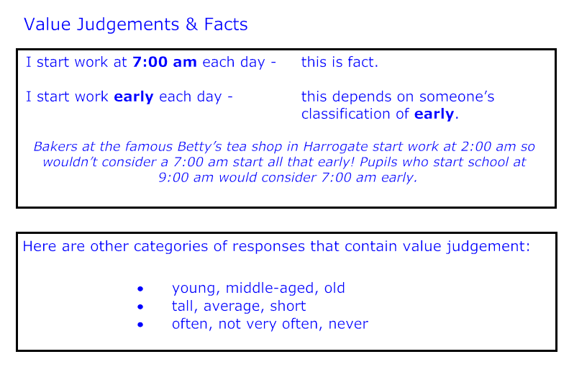

Slide 10
Activity
Create spider diagram to display information about encoding data.
Include:
What is encoding data
An example of encoded data
Two reasons why we encode data
Two advantages and disadvantages of encoding data
Two problems that can arise when encoding data

