Slide 1

What is E-Commerce?

Slide 2

Online Shopping
What is E-Commerce?

Slide 3
E-Commerce

Slide 4
Lesson Objectives
Understand the advantages and disadvantages for the customer and businesses when shopping online.
Understand the advantages and disadvantages for the customer and businesses when booking online.

Slide 5
How do you buy something online?

Slide 6
How do you buy something online?
Browse website using the Internet
Search a website for an item
Add items to a shopping basket
Proceed to checkout
Choose payment method
Enter card details
Enter address information
Email Confirmation

Slide 7

Online Shopping

Slide 9
How do you book something online?

Slide 10
How do you book something online?
Use the internet to search for what you want (Cheap Holidays in Spain 2016)
Pick specific requirements (full board, B&B etc)
Choose Date, number of people, rooms etc
Proceed to checkout
Choose payment method
Enter card details
Enter address information (or where to pick tickets up)
Email Confirmation

Slide 11
What can you book online?

Slide 12

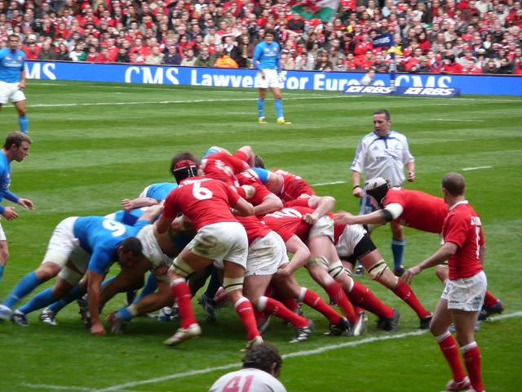


What can you book online?

Slide 13
Online Booking

Slide 15
Your Task
Create a how to guide on shopping online and booking online.
For each make sure you have 2 advantages and disadvantages for both the customer and business to make people aware of them.
It can take any form you want; PowerPoint, Poster, Leaflet etc

