Slide 1
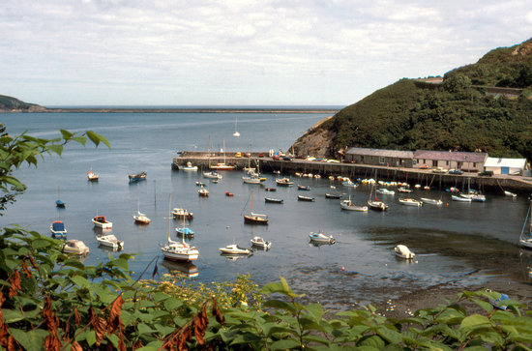
Open Microsoft Excel
Draw this image

Slide 2
Is it possible?

Slide 3
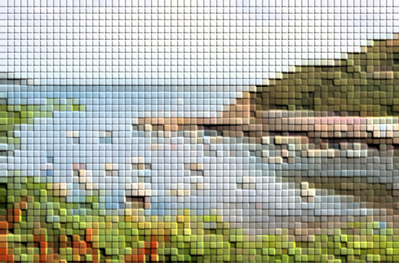

Slide 4
What's wrong with the image?

Slide 5
What does pixelated mean?

Slide 7
Better quality images

Slide 8
Image Capture

Slide 9
Objectives
Candidate must know:
basic digital photography
technology of capturing
storing and simple manipulation of images including cameras
megapixels
flash memory
display devices
photo editing software.

Slide 10
basic digital photography
Images can be:
- transmitted over internet
- manipulated using specialist software
- printed out on colour printer
- sent via mobile phone

Slide 11
technology of capturing
What devices can capture digital images?

Slide 12
storing and simple manipulation of images including cameras
How can we store images?
Secure Digital (SD) card
Compact Flash (CF) card
Memory card
Memory stick
USB Solid State Drive (SSD)
Optical storage (DVD/CD/BluRay)

Slide 13
megapixels
What is a megapixel?

Slide 14
flash memory
Flash memory is a storage device that doesn’t need power to store data.

Slide 15
display devices
How can we view images?

Slide 16
photo editing software.
Research 2 types of photo editing software and give examples of how you can manipulate images.

Slide 17
Discuss

Slide 18
Discuss
SD card, memory card etc
Photos can be edited; uploaded faster; view image immediately
Can be shared easily; better quality images…

Slide 19
Objectives
Candidate must know:
basic digital photography
technology of capturing
storing and simple manipulation of images including cameras
megapixels
flash memory
display devices
photo editing software.

