Slide 1
Value of Information

Slide 2
What is a manager?

Slide 3
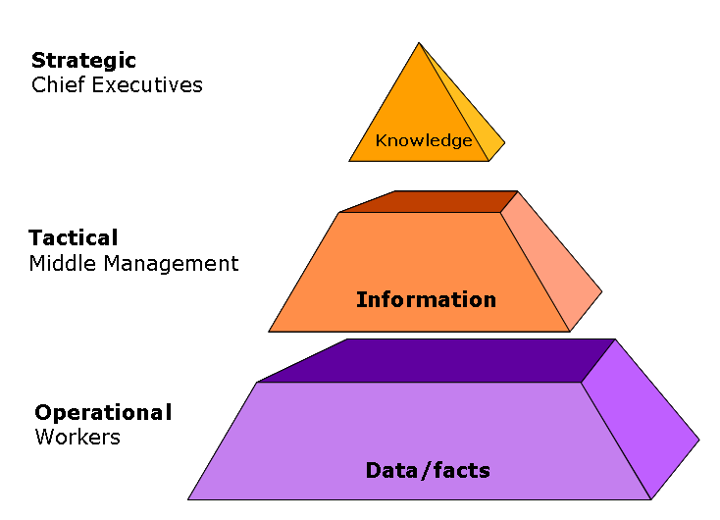

Slide 4
Information
The more valuable information collected - the less risk a decision becomes.
Information can be used to monitor progress.
Information can be used to target resources including money, HR, time etc.
Information can be used to gain or maintain competitive advantage.

Slide 5
Decision making
The quality of a decision depends on the quality of the information it is based on.
E.g. If a customer owes a large amount of money then no orders should be sent to them.
Simulations can be performed using spreadsheet software to experiment with ‘What-if’ scenarios to arrive at a decision.
More effective decision making = more success

Slide 6
Monitor Progress
Information can help to stay informed about how well it is doing.
Use ICT to monitor performance against set targets. Sales staff can judge their performance against previous years sales or other sales persons.
Monthly sales figures can be compared with previous monthly figures.

Slide 7
Targeting of resources
Organisations have limited resources, so efficient use will help to be successful.
Target advertising and marketing at those customers who are most likely to be interested in its products.
Creating production schedules
Planning projects
Stock control systems – ensuring stock is always available when needed

Slide 8
Gain a competitive advantage
Information can tell an organisation how well it is doing in relation to its competitors.
Use market research information collected from customers to understand why they choose the products etc
Ensure that customer orders are always satisfied by having accurate stock information
Anticipate customer demand e.g. Predict the amount of barbecue food sold during a hot spell from previous sales during hot spells.

Slide 9
Value of Information
Information is only of use if it is:
Up to date
Complete
Accurate

Slide 10
Up to date
Information should always be date stamped so there is no danger of using out of date information.
If it is personal data there is a legal requirement of the Data Protection Act 1998 for the information to be kept up to date.

Slide 11
Accurate
Information for a computer system must be as accurate as it can be because errors can result in problems.

Slide 12
Complete
It is important that all information is complete as incomplete information can cause a number of problems.
e.g.. An order might only be partly fulfilled.
e.g. Not all household income listed on mortgage application = no mortgage granted.

Slide 13
Activity
Write one example of a problem that could occur if information was:
Not up to date;
Not accurate;
Not complete.

Slide 14
Individual Research
Investigate the Tesco Club Card or Nectar Card and research what data is gathered, what happens with this data? Does this data become knowledge? Is the information gathered up to date, accurate and complete? What problems are there with these cards? Are there any privacy issues?
Create a report on your findings.

