Slide 1
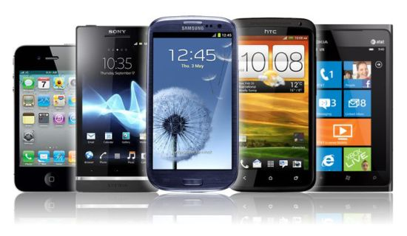
Smartphones

Slide 2
Lesson Objectives
To understand and demonstrate an understanding of Smartphones

Slide 3
What is a Smartphone?
A Smartphone is a portable device that is able to perform many of the functions of a computer, typically having a relatively large touch screen and an operating system capable of running general-purpose applications

Slide 4
Who has a Smartphone?
Who has a Smartphone on them now?
Take your Smartphones out.
What do they have in common?

Slide 5
Features of a Smartphone
Internet browsing
sending emails
gaming
making calls
navigating with GPS maps
sending messages
touch screen on most devices
Any More?

Slide 6
How can a Smartphone track what someone does?
Call Logs
Cookies
GPS
Internet History

Slide 7
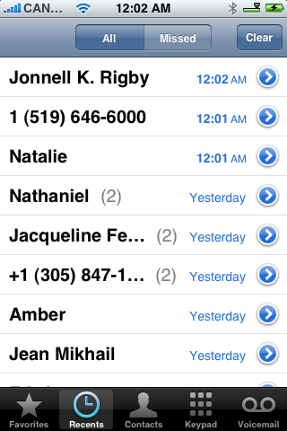
Call Logs
Smartphones keep a list of all your recent phone calls. They can provide a list of missed and answered calls.

Slide 8
Cookies
A cookie, also known as an HTTP cookie, web cookie, or browser cookie, is a small piece of data sent from a website and stored in a user's web browser while the user is browsing that website.

Slide 9
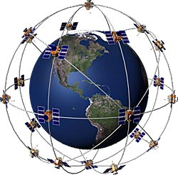
GPS
GPS Chip in Device
GPS Chip Picks up signal from satellite to determine location
This can then be sent via internet to 3rd Party
What Apps use GPS?
https://youtube.googleapis.com/v/ky4RgRvVDoA

Slide 10
Internet History
Your mobile phone keeps track of all the web pages you visited
You can then access your history if you wish to revisit a website

Slide 11
How can Smartphone’s connect to a Wired network
Smartphone’s can use their ‘Sync’ cable to connect to a Computer.
PCs on the other hand can connect to a wired network using Ethernet cable.

Slide 12
How can Smartphone’s connect to a Wireless network
Wifi - allows an electronic device to exchange data or connect to the internet wirelessly using microwaves (not microwave ovens)
3G or 4G - stands for third or fourth-generation and refers to technology that allows mobile phones to access the internet
Bluetooth - short-range wireless interconnection of mobile phones, computers, and other electronic devices

Slide 13
How can you communicate using a Smartphone?
Calling
Texting
Emailing
Video Conferencing (Facetime, Skype)
Using messaging apps (Whats app)
Social Networks
Any other ways?

Slide 14
Advantages of a Smartphone
Portable Devices that can fit in your pocket
Can perform similar tasks to that of a PC (Greater functionality)
A better battery life than most portable devices
On the go access to the internet
Allows you to work on the go
Better information sharing
Access to GPS
Entertainment
Any more?
I wish I had my...

Slide 15
Disadvantages of a Smartphone
Battery may ran out
If out of signal then phone functionality drops
Some have limited storage
Easily lost (How can apps help us?)
Easily damaged
Expensive to purchase and run (Contract)

