Slide 1
Simulation modelling

Slide 2
Your exam
Notes:
Section B – Spreadsheet
Some questions about Modelling in general
Some about the SpreadSheet

Slide 3
Lesson objectives
To be able to define and understand:
Definition of a simulation model.
Advantages and disadvantages of using simulation models.
Benefits of Spreadsheet software
Uses of simulation modelling for weather forecasting, car crash analysis and financial forecasting.

Slide 4
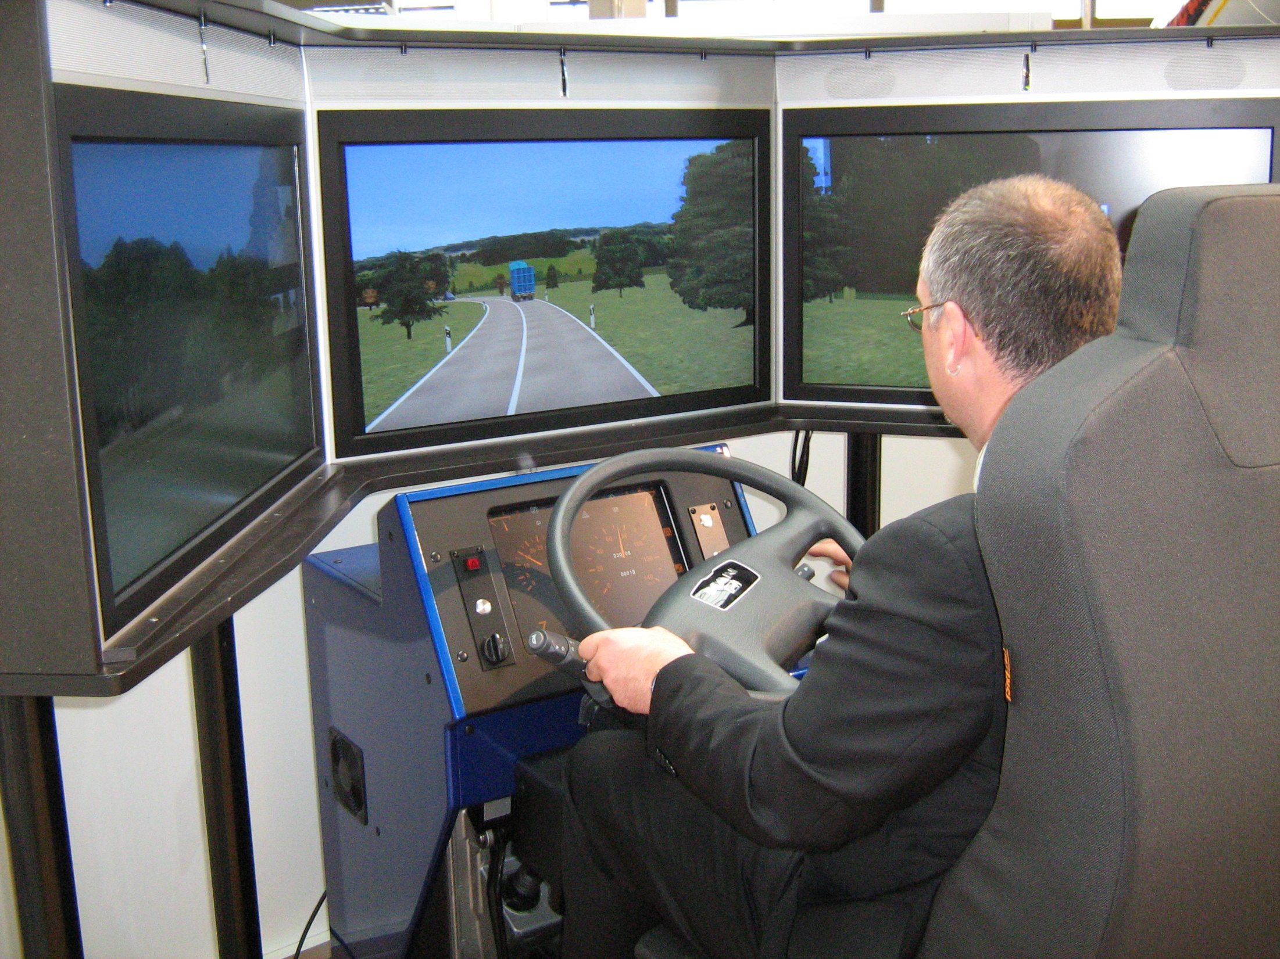
Notes:
Definition of a simulation model.
Advantages and disadvantages of using simulation models.

Slide 5
What is a simulation model?
Simulation modelling means using a computer and mathematical formulas to imitate a real life situation.

Slide 6
Advantages and disadvantages of simulation modelling
Advantages | Disadvantages
Enables predictions to be made in areas which may be dangerous to humans. It is usually much cheaper as do not have to crash planes or cars. Some situations cannot be performed in real life for testing purposes - a 10% price hike, making a nuclear reactor go critical. Easier to study long term affects by speeding up time scale or by slowing down. | Prediction only as accurate as the rules or data entered. Powerful expensive computer hardware needed to run the simulations. Some things, such as earthquakes, are hard to predict accurately and so hard to simulate.

Slide 7
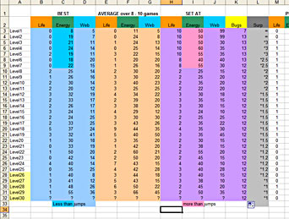
Notes:
Benefits of Spreadsheet software

Slide 8
Benefits of Spreadsheet Software
Automatic recalculation
Can do what if calculations
Can draw graphs for reports
Accurate calculation
Setting up templates to work quotes out more quickly

Slide 10
Weather forecasting
Advantages | Disadvantages
Only takes 1 hour to produce a 6 day forecast. Can predict path of hurricanes, etc. Can help farmers plan work. | 160 million equations solved – cost of buying a supercomputer. Long range forecasts cannot be 100% accurate in predictions.

Slide 11
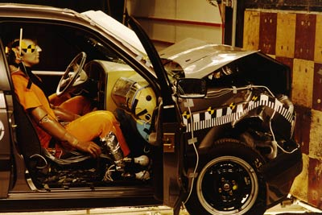

Slide 12
Car Crash Analysis
Advantages | Disadvantages
Cheaper as do not have to physically destroy cars. Safer as nobody is really hurt Much more flexible Can explore different scenarios more easily | Model could oversimplify the situation and not be accurate enough Bad data errors in formulas will spoil accuracy No model is ever 100% accurate

Slide 14
Financial forecasting
Advantages | Disadvantages
Possible to experience a lot more situations Cheaper as not going to waste money on impossible actions It can save time as you can roll on the model to see what it is like after more than one year | There will always be some difference between simulation and reality Accuracy of the rules and variables Some situations are hard to model.

