Slide 1
Human Computer Interface

Slide 2
Human Computer Interface?
HCI is not just about software design
HCI applies to more than just desktop PCs!!!
No such thing as “the best HCI”. Choice of interface will depend on:
Physical environment
Experience of users
Amount of info that needs to be gathered/conveyed

Slide 3
Good Interface Design 1
Users should be able to use an interface:
SAFELY
Tasks can be completed without risk – e.g. flying an aeroplane.
EFFECTIVELY
Being able to do the right task and do it well – e.g. videoing a TV programme
EFFICIENTLY
To carry out tasks quickly and correctly – e.g. at a cashpoint
ENJOYABLY
Users should be able to enjoy what they are doing, not be frustrated by the interface – e.g. educational programs

Slide 4
Good Interface Design 2
There are four considerations for an interface designer:
WHO
Who is going to use the system, what are their ages, etc.?
WHAT
What tasks are they likely to want to perform? Repetitive, complex, simple, etc.
ENVIRONMENT
Where is the computer to be used? In a hazardous or noisy environment?
What is technologically available? Designers should not add elements to the interface that cannot actually be used out easily.
FEASIBILITY

Slide 5
User Interfaces – 4 Types
Command Line Interface (CLI)
A CLI displays a prompt, the user types a command on the keyboard and executes the command. The computer executes the command, providing textual output.
2. Menu Driven Interface
The user has a list of items to choose from, and can make selections by highlighting one.

Slide 6
User Interfaces – 4 Types
3. Graphical User Interface (GUI)
Uses windows, icons, menus and pointers (WIMP) which can be manipulated by a mouse (and often to an extent by a keyboard as well).
4. Natural Language Interface
Can range from simple command systems to voice activated text processing. Commands are spoken in “normal” language.

Slide 7
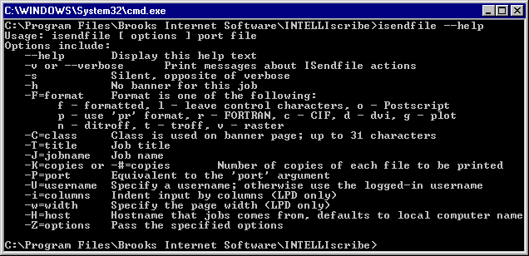
Command Line Interfaces 1
Advantages
Very flexible with the use of “switches” (options)
Good for “expert” users - can quickly access commands
Uses the fewest system resources

Slide 8
Command Line Interfaces 2
Disadvantages
Requires the user to learn “complex” commands or language
“Hidden” features i.e. if you don’t know the commands you wont know the features are there!
Not very good for novice users

Slide 9
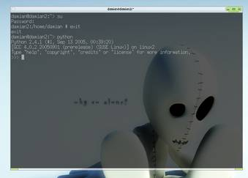
Command Line Interfaces 3
Command Line Interface Applications
System administration
Engineering applications
Scientific applications
Ideal for visually impaired users!!!

Slide 10
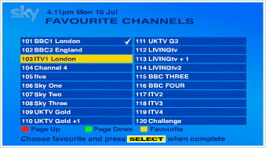
Menu Driven Interfaces 1
Advantages
No need to learn complex commands/language
Easier for a novice to learn/use
Ideal when there are a limited number of options (efficient)

Slide 11
Menu Driven Interfaces 2
Disadvantages
Can be frustrating for experienced users i.e. the command they want to use is buried 5 levels deep!!!!
User interface may be limited by screen space and number of options available

Slide 12
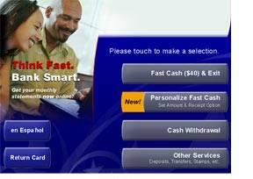
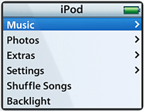
Menu Driven Interfaces 3
Menu Driven Applications
ATM
Mobile Phone
MP3 Player
Video recorder
Household Devices
Digital/Cable TV

Slide 13
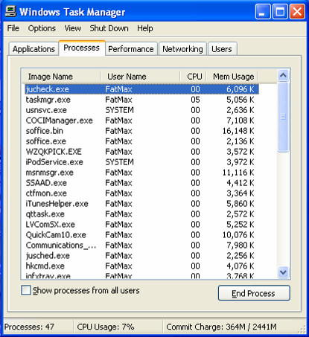
Graphical User Interfaces 1
Most suitable interface for inexperienced or novice users but…
GUIs use more system resources than other types of interface

Slide 14
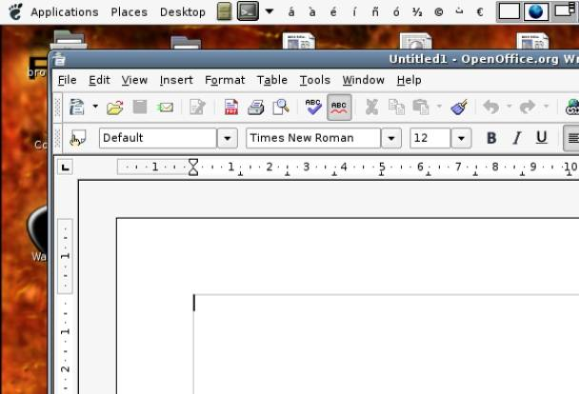
Graphical User Interfaces 2
Many generic packages for a GUI will share common features
Layout of the screen
Names given to commands
Icons
Order of menus
Mouse operation
Dialog boxes

Slide 15
Benefits of a common interface
There are five advantages to the ‘common user interface’:
1 Increased speed of learning
2 Ease of use
3 Confidence for novice users
5 Greater range
of software
available to
the average
computer user
4 Increase the range of
solvable tasks by users

Slide 16
Natural Language Interfaces 1
Advantages
No training required – you just tell the computer what you want to do!
Can be quicker than keyboard entry
Hands-free – could be invaluable in some environments
Can be used by the disabled

Slide 17
Natural Language Interfaces 2
Disadvantages
Emerging technology – still contains “bugs”
Difficulty dealing with homonyms
Difficult to recognise all the different ways of saying things (and regional dialects)
Artificial languages are often more precise

Slide 18
Biometric Devices
There are many ICT systems that can recognise a particular person by certain biological features such as:
The pattern of blood vessels on the retina
Finger/hand prints
Voice
Face
Biometric devices are currently used for:
Recognition & Registration systems in schools / colleges
Recording employees as they clock in and out of work
Limiting access of computers to authorised staff
Future uses include:
Passport Control
Admission to clubs and bars

Slide 19
Touch Screen Technology
Touch sensitive screens allow the user to make selections by touching specific areas of a screen. Typically they are used for:
Purchasing train tickets
Information points in museums or galleries
Mobile phones
Self-service checkouts in supermarkets
Satellite Navigation systems
The main advantages are:
Suitable for the novice user
Generally intuitive
Easier to use as no typing skills required
By using picture icons that are not always language dependant

