Slide 1
Encoding Data

Slide 2
What is encoding data?
Definition: Data that is coded during collection or when input into an ICT system.
Examples include:
Country of origin for cars | Size of clothes
GB = Great Britain D = Germany IRL = Ireland CH = ? | S = Small M = Medium L = Large XL = Extra Large

Slide 3
Reasons for Encoding Data
Coded data takes less time to type in; Male vs M
Increase accuracy of data entry – less chance of mistakes
It is easier to check if a code is correct using validation checks – set up validation so field will only accept ‘M’ or ‘F’
Takes up less storage space; Female vs F
Faster searching for data – smaller databases are faster to search and produce results

Slide 4
What are the problems of encoding data?
The main problem with encoding data is that it coarsens the precision. This means the data is less accurate after it is encoded.
e.g. If inputting peoples eye colours into a database we could encode them like this:
BL - Blue, GR - Green, BR - Brown, GY - Grey.
If someone had Green/Blue eyes we would have to choose one or the other, so the data becomes inaccurate and we question the integrity of the database.
The data stored is not as precise as the original data.

Slide 5
Example A
At the supermarket checkout, the bar code is scanned to enter data in the form of a product number.
but when the receipt is printed out the name of the product is displayed.

Slide 6
Activity
Look up 5 different country codes. Which ones are obvious and which ones are not so obvious?

Slide 7
Value Judgements
Encoding data often involves the person collecting or entering the data in making judgements about which code to use.
These are called value judgements. The problem with value judgements is that they are based on someone’s opinion which could differ from someone else’s opinion.

Slide 8
Value Judgement Example
Mohammed 5ft 5inches
Chloe 4ft 11inches
James 5ft 9inches
Jack 6ft 5inches
Mary 6ft 2inches
Jane 5ft 7inches
How would you encode these in T, M and S (tall, medium and short)?

Slide 9
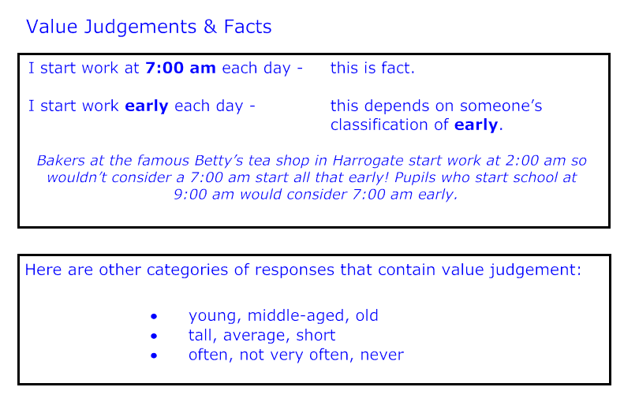

Slide 10
Subjective Value Judgements
Sometimes you are asked to complete a survey which will contain for example:
On a scale of 1 to 10, or circle what you think of the course Good…Very Good…Excellent etc.
Again these options are subjective to a person’s opinion and view of what is meant by the term Very Good.
My Very Good could be different from yours.

Slide 12
Activity - Pairs
Create an A5 leaflet and using a suitable example, explain how and why we encode data;
Also include at least two advantages and disadvantages of encoding data;
Please remember to include the key words;
Use a suitable colour scheme appropriate to your audience.

