Slide 1
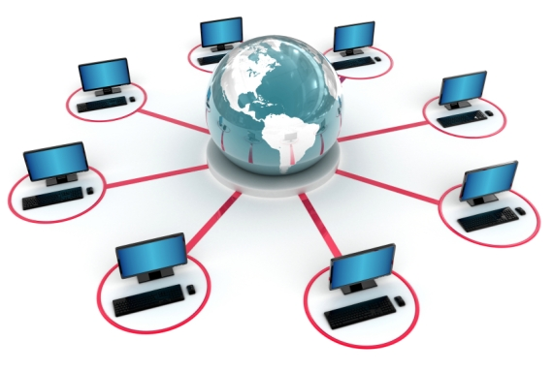
Distributed computing using the internet

Slide 2
Lesson objectives
To be able to define Distributed Computing
To develop an understanding of why people use Distributed Computing
To understand the advantages and disadvantages of Distributed Computing

Slide 3
Starter Task
Nominate one person (Group A)
Everyone else work in pairs of threes (Group B)
Open up a calculator on the computer.
There are 10 sums to complete.
Group A is to complete all the sums.
Group B – split up the sums between groups
When asked each group will complete their sums, and stand up when they are finished.

Slide 4
Questions…
245 * 76
15000 / 2.5
169875 – 9521
1200 * 0.3
0.01 * 5000
9999 / 11
632 + 3982
(7 * 6) / 2
(9 + 8) * 100
987654321 - 123456789
18620
6000
16035
1560
50
909
4614
21
1700
864197532

Slide 5
Why?
Tasks can be completed quicker when a task is shared between different groups

Slide 6
Distributed Computing
Sharing the same data procession task/project between different computers on a network
Advantages | Disadvantages
Reduces cost because a super computer is not needed | Issues with the security of data spread out on so many different computers
Can pass work to computers anywhere in the world using the internet | Heavy reliance on networks and communications which may not always be reliable
Improved performance as each computer can work on part of the data | Increased costs owing to the use of expensive communication lines

Slide 7
Who uses Distributed Computing?
The ‘SETI’ Project – Search for Extra-terrestrial Intelligence
SETI use DC to search for intelligent life outside of earth using a radio telescope
In order to search for narrow-bandwidth signals lots of computing power is needed
They use a virtual super-computer consisting of a huge number of home computers connected to the internet
The Popular Power Project – Helps to develop flu vaccines
They use DC to develop flue vaccines

Slide 8
How do they use it?

Slide 9
Visit these websites to learn about how and why companies use distributed computing.
http://setiathome.ssl.berkeley.edu/
http://en.wikipedia.org/wiki/Popular_Power
http://news.bbc.co.uk/1/hi/sci/tech/866193.stm

Slide 10
Exam Questions
Explain what is meant by distributed computing and describe an application which uses it. (5)
What are the advantages and disadvantages of using distributed computing? (4)

Slide 11
Lesson objectives
To be able to define Distributed Computing
To develop an understanding of why people use Distributed Computing
To understand the advantages and disadvantages of Distributed Computing

