Slide 1
Draw a Ring, Bus and Star network.
In pairs/groups, draw what you think a ring, bus and star network looks like.

Slide 2
Network Topologies
Networks

Slide 3
Lesson Objectives
Candidates should understand:
What a topology is.
The Bus, Ring and Star topologies
The advantages and disadvantages of each topology

Slide 4
What is a topology?
Physical configuration/layout of how a network is connected/linked together

Slide 5
Bus, Ring and Star

Slide 6
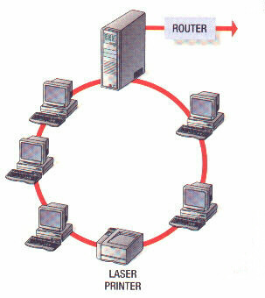
Ring Network

Slide 7
Ring Network
In a ring network layout, all of the computers are connected to one another in a circle. The data passes from one computer to the next one and then all the way around the ring layout until it reaches the destination computer.

Slide 8
Advantages of ring
Network not dependant on central computer
Each computer has the same access as the others so no one computer can hog the network
Disadvantages of ring
If there is a break in the connection then the whole network fails
Faults are difficult to locate
It is impossible to keep the network running whilst equipment is added or removed
because there is only one path for the data to follow

Slide 9
Lesson Objectives
Candidates should understand:
What a topology is.
The Bus, Ring and Star topologies
The advantages and disadvantages of each topology

Slide 10
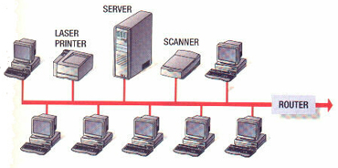
Bus Network

Slide 11
Bus Network
This is one method of connecting computers together and is the simplest one to connect together.
A single cable joins all of the workstations, printer, file server and other components together. At each end of the bus is a 'terminator'. This is a piece of hardware which prevents signals bouncing back and forth (echoes).

Slide 12
Advantages
Easy to install
Easy to add extra workstations
Uses less cable than a Star network
Best choice for temporary networks
Disadvantages
If there is a problem with the central cable/backbone, the entire network stops working
If there are a lot of workstations on the network, data can travel slowly.
Data collisions can happen as the network becomes busy
Low security - every workstation can see all of the data in the network

Slide 13
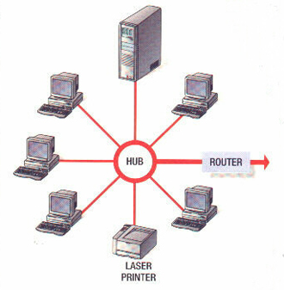
Star Network

Slide 14
Star Network
In a star network layout, each workstation is connected by its own cable directly to the server. Star networks are usually the layout of choice in schools and offices because they tend to be the most reliable of the topologies.

Slide 15
Advantages of star
Fault tolerant – if one of the cables fails, then the other computers can still be used
Load tolerant – extra computers can be added without much loss in performance because all computers have their own path to the server
Easy to add extra computers – extra computers can be added without disturbing the
Disadvantages of star
Higher cost – the large amount of cabling needed makes it more expensive
Dependence on the central server

