Slide 1
Client server vs Peer to peer
Networks

Slide 2
Lesson objectives
Candidates should understand the advantages and disadvantages of:
client server networks
peer to peer networks

Slide 3
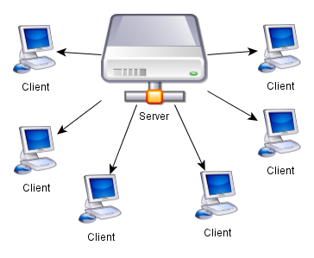
Client Server network

Slide 4
Client Server
More expensive – servers are expensive to buy
Cost of setup and maintenance is higher
One machine more important than the rest
Need specialist knowledge; need a person with technical knowledge to manage network
Network manager allocates access to resources on the network
Network operating systems require technical knowledge to set up and maintain
If server breaks down network is unusable

Slide 5
Client Server
Users need little specialist knowledge as administration is performed centrally
Security is better as it is centralised and one persons responsibility (NOT just hierarchy of passwords)
Backups and software installation can be done centrally
Centrally stored files are easier to find
More efficient / load tolerant for large networks

Slide 6
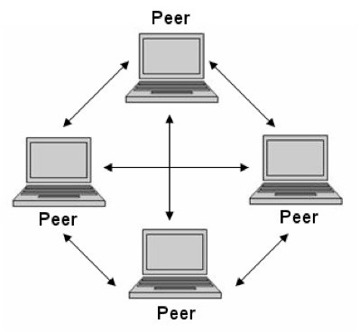
Peer to Peer

Slide 7
Peer to peer
Cost saving – no server is needed, so all the computers can be the same
Lower operating costs – less set up and maintenance costs
Status – All machines have same status
No network manager is needed – all users take responsibility for the network
Knowledge - Users need more IT knowledge
Easy to set up – they are the simplest of computer networks, can be set up by anyone

Slide 8
Peer to peer
No reliance on a server – no worry about the server breaking down
Peer responsibility – users decide what resources others can use on their computer
Security - Poorer security as resources are shared
Back ups cannot be made centrally – this places the responsibility on all the users to back up their own data
Harder to find files which are not stored centrally
Network size - Only suitable for very small networks (15 or less)

Slide 10
Exam Question
A company needs to change its network. Compare and contrast client server versus peer to peer networks for the company. [6]

Slide 11
Lesson objectives
Candidates should understand the advantages and disadvantages of:
client server networks
peer to peer networks

