Slide 1
System Development Life Cycle
Changeover Strategies

Slide 2
Lesson Objectives
To Develop an understanding of the different changeover strategies when introducing a new ICT system.

Slide 3
Changeover
Direct
Parallel
Phased
Pilot

Slide 4
Direct Changeover

Slide 5
Stop using the old system one day and start using the new system the next day (1).
Element of risk particularly if the hardware and software are cutting edge (1).
If the system fails then it can be disastrous to the business Requires fewer resources (people, money, equipment) and is simple, provided nothing goes wrong
Need more than easiest/quickest and not just cheapest

Slide 6
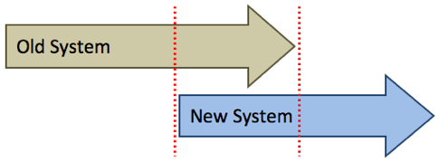
Parallel Changeover

Slide 7
Old ICT system is run alongside the new ICT system for a period of time until all the people involved with the new system are happy it is working correctly
Used to minimise the risk in introducing a new ICT system
Can compare results and be sure it is working properly
Lots of unnecessary work (as the work is being done twice) and is therefore expensive in people’s time
It also adds to the amount of planning needed for the implementation

Slide 8
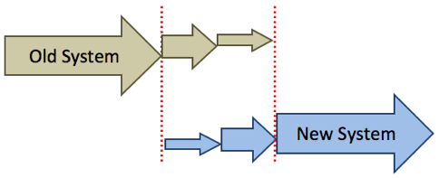
Phased Changeover

Slide 9
A module at a time can be converted to the new system in phases until the whole system is transferred
Advantage that IT staff can deal with problems caused by a module before moving on to new modules
Is only suitable for systems consisting of separate modules

Slide 10
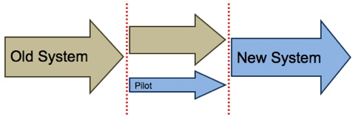
Pilot Changeover

Slide 11
This method is ideal for large organisations that have lots of locations or branches where the new system can be used by one branch and then transferred to other branches over time
Implementation is on a much smaller and manageable scale
Disadvantage is that is takes longer to implement the system in all the branches

Slide 12
Past Paper Questions
A system analyst has a choice of direct changeover or parallel running when updating a computer system. Describe these two different potential changeover strategies and describe the advantages and disadvantages of each of the different strategies. [6]
Once the new computer system is up and running, it has to be maintained. Describe two different system maintenance methods and illustrate each method with appropriate examples. [6]

