Slide 1
E-commerce The requirements of interactive shopping

Slide 2
Lesson objectives
You must ensure you understand:
The requirements of maintaining a company website.
The advantages and disadvantages to both the customer and business.

Slide 3
Starter Activity
Go onto an e-commerce website, i.e. Ebay, Amazon etc
Look for a laptop and proceed to buy it
What did you use to find a laptop?
What happened to your item when you tried to buy the item?
Where did the details of the item come from?

Slide 4
Starter Activity
What did you use to find a laptop?
The search facility.
What happened to your item when you tried to buy the item?
It went to your basket of shopping trolley.
Where did the details of the item come from?
A electronic catalogue or stock database.

Slide 5
The main requirements for an on-line shopping based service.
Trained staff to create and maintain the website
An electronic catalogue of stock
A search facility
Methods of secure payment/Shopping trolley
Database of customer orders
Order confirmation/email confirmation

Slide 6
Trained staff to create and maintain the website
Staff need to be able to update the site with new products, prices and new features.
These staff require technical expertise and design skills.

Slide 7
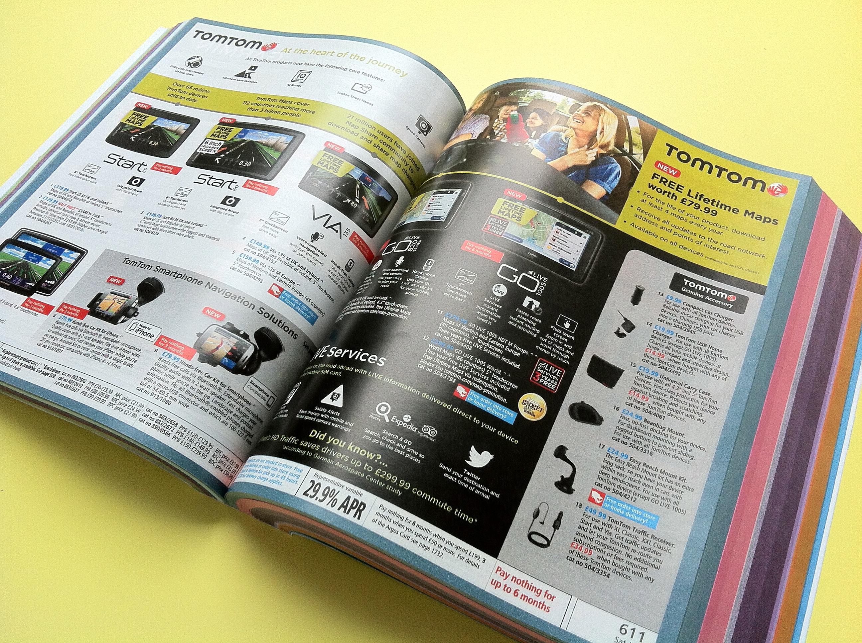
An electronic catalogue of stock
A database with a user interface that provides information on products (think of your Unit 2 Spreadsheet)

Slide 8
A Search facility
A search facility allows a user to go straight to a product they are interested in.
It uses the keywords to search the stock database for relevant items

Slide 9
Methods of secure payment
Customer details must be kept secure when transmitted over the internet

Slide 10
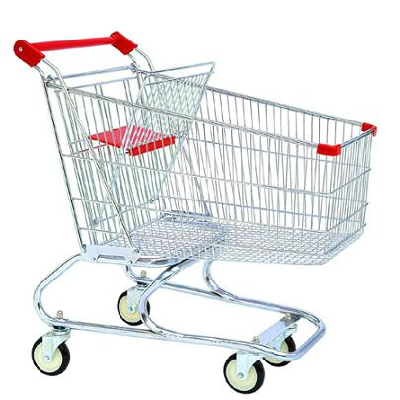
Shopping trolley

Slide 11
Database of customer orders

Slide 12
Order/email confirmation

Slide 13
The advantages and disadvantages to both the customer and business.
Discuss
Advantages for customer
Disadvantages for customer
Advantages for business
Disadvantages for business

Slide 14
Customers
Advantages | Disadvantages
Ability to order goods 24/7 | Problems with fraudulent/fake websites; credit card fraud
There it no travelling – savings in costs and time; also delivered to door | Lack/loss of social interaction
Allows disabled people to do their own shopping | Can’t fully assess the quality of the goods; can’t try things on
You can see customer reviews | Hidden costs of postage and packing
Greater choice of goods which may not be available locally | May have a problem returning goods

Slide 15
Business
Advantages | Disadvantages
Customers can email enquiries, orders and requests | Need to employ fully trained staff
Wider customer base/global audience | Competitors can see your prices and target your company
Lower start up and running costs; large savings on shop, warehouse and office space | Increase in the reliance of delivery vans
Easy to update and alter online catalogues | Extra costs incurred from hosting website and deliveries

Slide 16
Exam Questions
A shop selling memorabilia already has a website and computer systems. The shop owner wants to expand and offer the customers an on-line shopping service. Describe in detail four main requirements needed for an efficient on-line shopping service. (4)
Discuss the advantages and disadvantages of on-line shopping to both the business and the customer. (8)

Slide 17
Lesson objectives
You must ensure you understand:
The requirements of maintaining a company website.
The advantages and disadvantages to both the customer and business.

